Slide 1



Why and How to Manage TDS Data
FoodCASE - A TDS Data Management System
David Weber (ETH Zurich)
TDS Workshop, Brussels, 25th March 2015

Slide 2
Outline
Why to manage TDS data
What data needs to be managed
How data needs to be managed
Concepts for data management
Use cases / Implementation in FoodCASE
Data quality in FoodCASE

Slide 3
David Weber
MSc in Computer Science with focus on information systems and business informatics
Several years of work experience as software engineer in the financial industry
PhD student at ETH Zurich
3 years experience with food composition and TDS data management system
Research interest on data quality

Slide 4
Why to manage TDS data?

Slide 5
Why to Manage TDS Data
Preserve data for long-term access
Increase the visibility of your work
Save time and resources in long run
Enable other to access your data
(in a unique way)
Open data means that publicly funded data must be publicly available (EU directive)

Slide 6
Why to Manage TDS Data
Enhance data security
Minimise risk of data loss
Meet grant requirements
See data as a product for which funding were used
Documentation of your data (evidence) ensures data integrity and replication
Facilitate new discoveries

Slide 7
Linkage of Food Items
Food Data Application
Food Consumption
Food Composition
Food
Food
Linkage
Food Monitoring
Food
TDS Exposure
Food

Slide 8
Take Home Message I
TDS data is the output of your work and your asset.
Take care of it.

Slide 9
What Data Needs to be Managed?

Slide 10
What Data Needs to be Managed?
Analogy with a research paper:
Title of Research Paper
Literature Review
Results
Abstract
Method
Introduction
Discussion

Slide 11
What Data Needs to be Managed?
Analogy with a research paper:
Title of Research Paper
Literature Review
Results
Abstract
Method
Introduction
Discussion

Slide 12
What Data Needs to be Managed?
Analogy with a research paper:
Title of Research Paper
Literature Review
Results
Abstract
Method
Introduction
Discussion

Slide 13

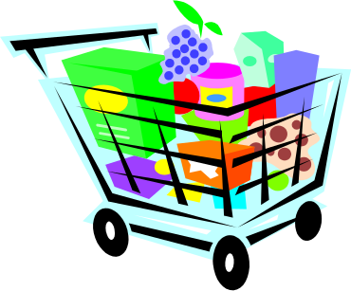

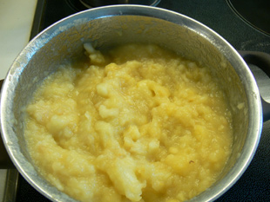
How does a TDS work?
Food 1
Food 2
Food 3
…
Food A
Food B
Food C
…
prepare as consumed
Food A
Food B
Food C
…
pool
plan
Pooled food X
Collect food according to consumption info

Slide 14


How does a TDS work?
Nutrient values
Contaminant values
Pooled food X
Recommendation
analyse
Assess risk

Slide 15
Management of TDS Data
Preparation information
Sampling information
Pooling information
Food information
Analysis information
TDS Data Repository
Substance value information
Consumption information

Slide 16
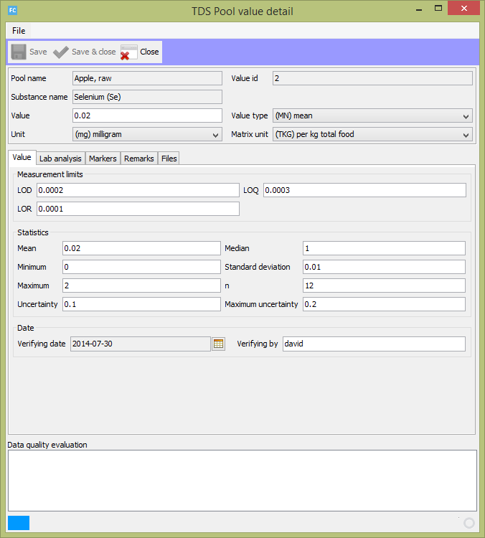

Slide 17
Take Home Message II
Value documentation is crucial for scientific evidence.

Slide 18
What Data Needs to be Managed?
Until now every country did its own TDS and collected data according to their requirements.
One goal in the TDS-Exposure project is to establish recommendations what data should be collected.

Slide 19
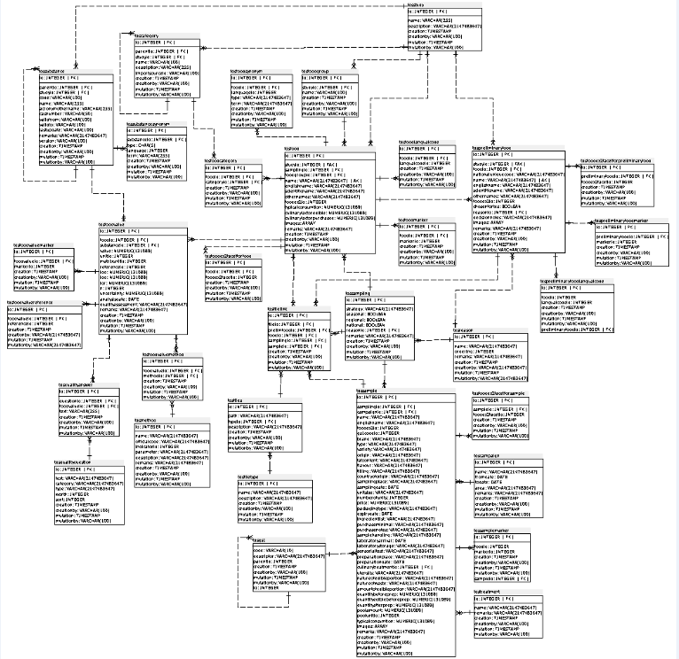
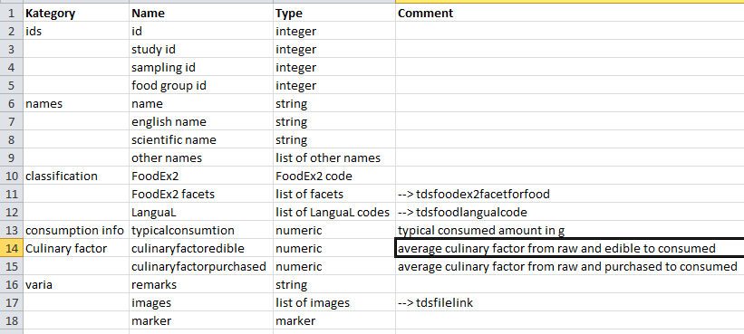
What Data Needs to be Managed?

Slide 20
What Data Amount Needs to be Managed?
The following numbers were identified:
200 foods
96 attributes per food and 49 for one compound value
Example:
200 food items with about 10 compounds -> at least 117’200 data points

Slide 21
Take Home Message III
Use a feasible tool to manage your TDS and make your data sustainable.

Slide 22
How Data Needs to be Managed?

Slide 23
TDS Data Entities and Levels
Entity = Real world object such as chair or table
Data Levels = Different stages that data go through in a database

Slide 24
TDS Data Entities and Levels
Single Sample Food
Sample level
Prepared Sample Food
Pooled Sample Food
Analysed Food
e.g. apple, raw
Analysed value level
Substance Value
e.g. 0.3 g protein
Substance Value
e.g. 5 mg vitamin C
Substance Value
e.g. 1mg mercury
Substance Value
e.g. 2mg selenium

Slide 25
TDS Data Entities and Levels
Analysed Food
e.g. apple, raw
Analysed value level
Substance Value
e.g. 0.3 g protein
Substance Value
e.g. 5 mg vitamin C
Substance Value
e.g. 1mg mercury
Substance Value
e.g. 2mg selenium
Data usage level
Analysed Food
e.g. apple, raw
Substance Value
e.g. 1mg mercury
Substance Value
e.g. 2mg selenium

Slide 26
Take Home Message IV
TDS data goes through a data live cycle.

Slide 27
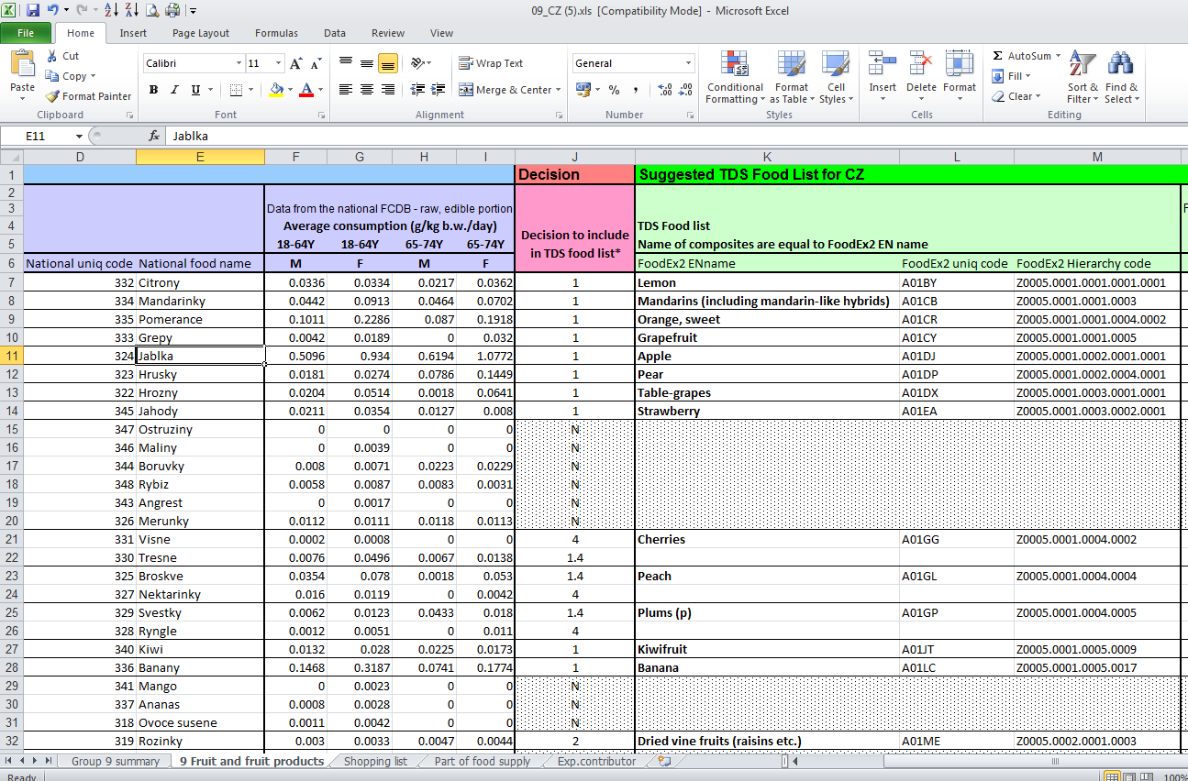

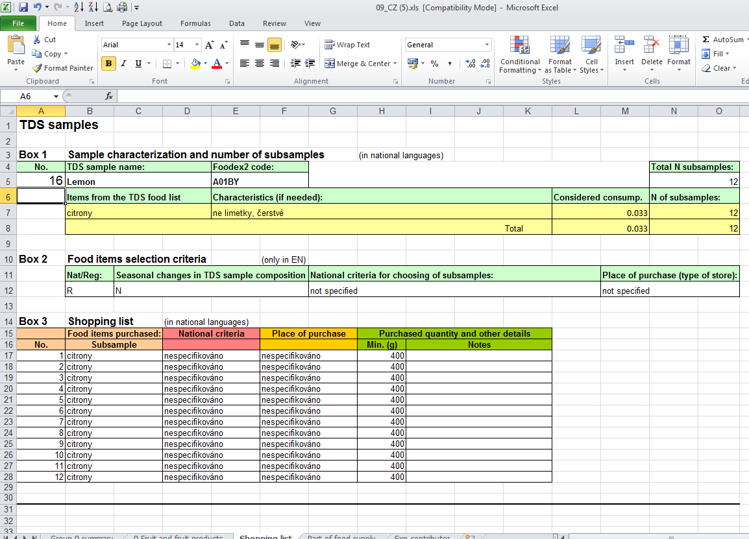

How to Work with a TDS Data Management System?
Assemble food list
Different data sets are needed: food comp data, consumption data and former TDS data
Assemble shopping list
Planning Phase
EXCEL is a handy tool to manipulate multiple entries.
Issue: 18 EXCEL files (one for each food category)
Prepare samples
Form pool groups
t

Slide 28
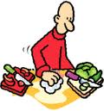
How to Work with a TDS Data Management System?
Collect food items
Prepare samples
Execution Phase
Form pool groups
Only deviation from original plan must be documented.
Analyse food items
t

Slide 29
How to Work with a TDS Data Management System?
LIMS
Enter substance values
Lab Analysis Phase
Archive data
Export data for risk assessment
t

Slide 30
Take Home Message V
A good TDS data management system does not restrict you in your TDS approach. It rather supports your value documentation and risk assessment.

Slide 31
Concepts for Data Management

Slide 32

TDS Data Markers
Concept 1:
Add information to data which is unlimited,
user-defined and semantical
Apple, fresh
TDS 2008
Patulin source
(mycotoxine)
Most often consumed food

Slide 33
TDS Data Markers
Concept 2:
Structure markers to simplify overview
TDS
Fortified
TDS 2008
with Vit C
TDS 2012
with Vit D

Slide 34
TDS Data Markers
Concept 3:
Markers are searchable
Search food items which were not used in the TDS 2008
but in TDS 2010
and are fortified with vitamin C
“TDS 2008” AND NOT “TDS 2010” AND “fortified with vit C”

Slide 35
Take Home Message VI
Markers is a flexible concept for semantical data tagging.

Slide 36
Reports and Exports of TDS Data
Reporting/Exporting means
to search and prepare existing data,
to bring it into a usable form such as table or graphic,
and to put it into a human or computer readable file format such as PDF or EXCEL

Slide 37
Reports and Exports of TDS Data
Challenge: Reports are useful but exist in endless number of variations and implementation costs.
Solution:
Data must be selectable for use in report/export
User should be able to define their own reports in terms of form and format

Slide 38
Take Home Message VII
Report and Export functionalities should satisfy needs and in best case can be extended by users.

Slide 39
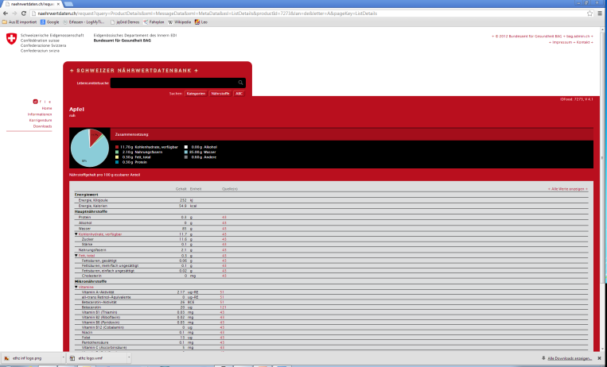
Architecture of a Food Information System
Database
Web Level
Database Level
Web Services
Server Level
Application Server
Web Server Component
Graphical User Interface (GUI) Level
Food Data Application
Food Composition Data
TDS Data
Admin Application
User Admin
Food Consumption Data
Reference
Thesauri
Marker
Data Quality Prevention
Data Quality Analysis
…

Slide 40
Use Cases in FoodCASE

Slide 41
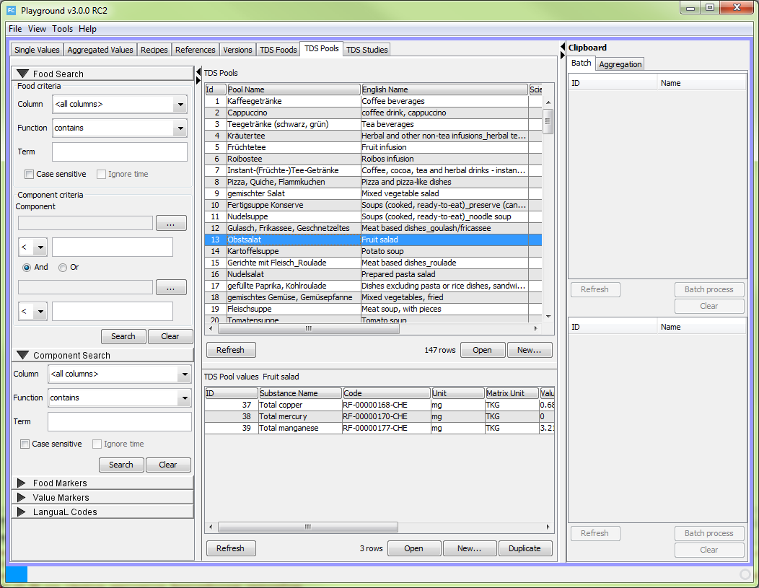
Starting Mask - Overview
Search Area
Data Listing Area
All or certain columns
Content of substances
Data markers
LanguaL / FoodEx2 codes
Food items
Chemical occurrences
(beneficial and
harmful substances)

Slide 42
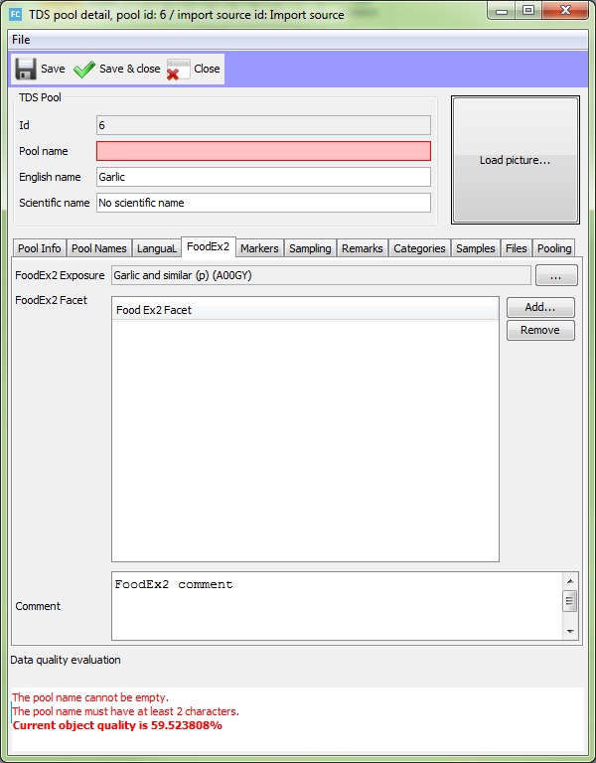
Managing Food
Mandatory fields
Many other attributes for a single food
Data quality panel

Slide 43
Managing Analysed Values
Laboratory report
Other scientific publication
Basic idea:
Provide as much value documentation as possible
Attach original published document

Slide 44
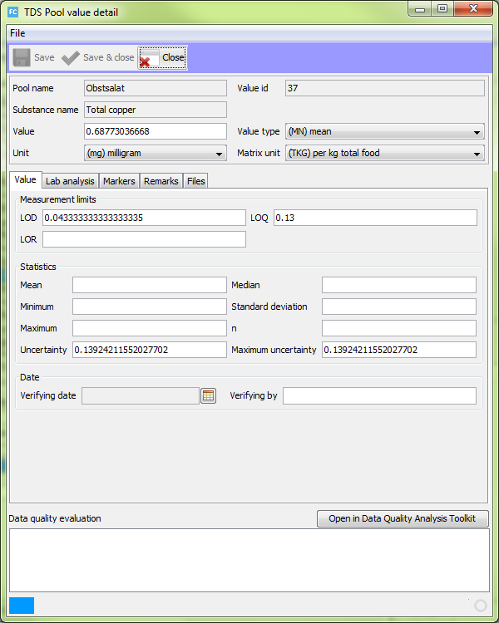

Managing Analysed Values
Many available attributes
Data quality panel

Slide 45
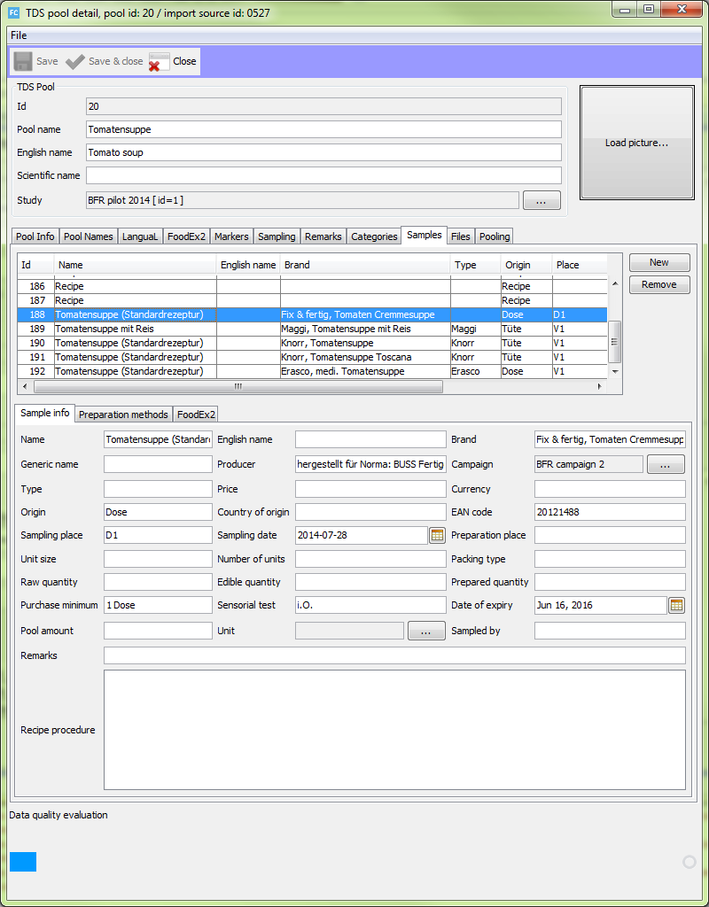
Managing Samples
Attribute values depending on the table selection

Slide 46
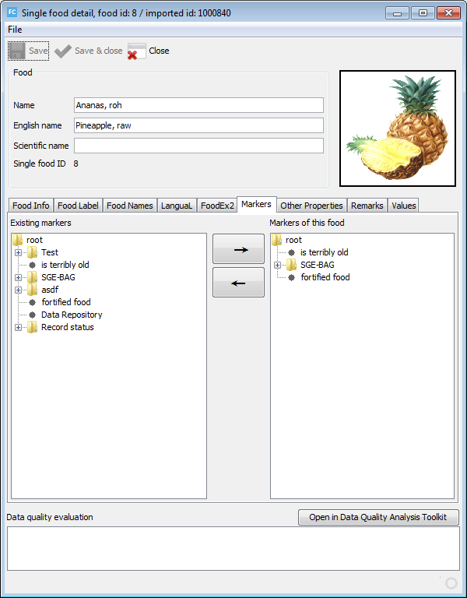
Markers
Available markers
Assign or remove from current food item
Definition of markers in the Admin client
Custom naming
Multilevel markers for TDS

Slide 47
Take Home Message VIII
FoodCASE contains all necessary concepts and user Interfaces are simple structured and intuitive.

Slide 48
Data Quality in FoodCASE

Slide 49
Data Quality (DQ)
Definitions of data quality:
Data or information has quality if it is appropriate for the intended use
The quality of data or information depends on users’ expectations and requirements

Slide 50
Data Quality Requirement (DQR)
A data quality requirement is a concrete intrinsic or contextual constraint to data that helps to satisfy an aspect or construct of data quality.

Slide 51
Data Quality Requirements
Food name must be unique
Substance value should not be older than 10 years
Food should have at least substance values for mercury and selenium.
Rating
Rating
Rating
W=10
W=100
W=60
Data Quality
Rating

Slide 52
Data Quality Framework (DQF) concept
Managing and measuring data quality (DQ)
Constraints as DQ indicators
Unique definition and validation
Flexible and highly configurable DQF
  Importance weights for constraints
  Grouping of constraints
  DQ contracts for different users
  Various visualisations

Slide 53
DQF Weights & Contracts
User can define weights and threshold
  0: Not important, 100: Most important
  Threshold between warning and error
  Default weight
A contract defines the weight (importance) for each of the constraints
Default contract exists as fallback
Users can define their (multiple) own contracts
Contracts can easily be imported and shared

Slide 54
Types of DQ Requirements
Food name must be unique
Hard constraints → Error
Determines if data is deficient or not
Soft constraints → Warning
The more requirements are satisfied, the better is data quality
Indicators → Warning
Indicate better quality but quality improvement is not evident
Food should have at least substance values for mercury and selenium.
Substance value should not be older than 10 years

Slide 55
Data Quality Rating
Can be simple as ‘satisfied’ or ‘not satisfied’ or more complex, for instance 0 to 100
Can be defined by user
Food name must be unique
Rating

Slide 56

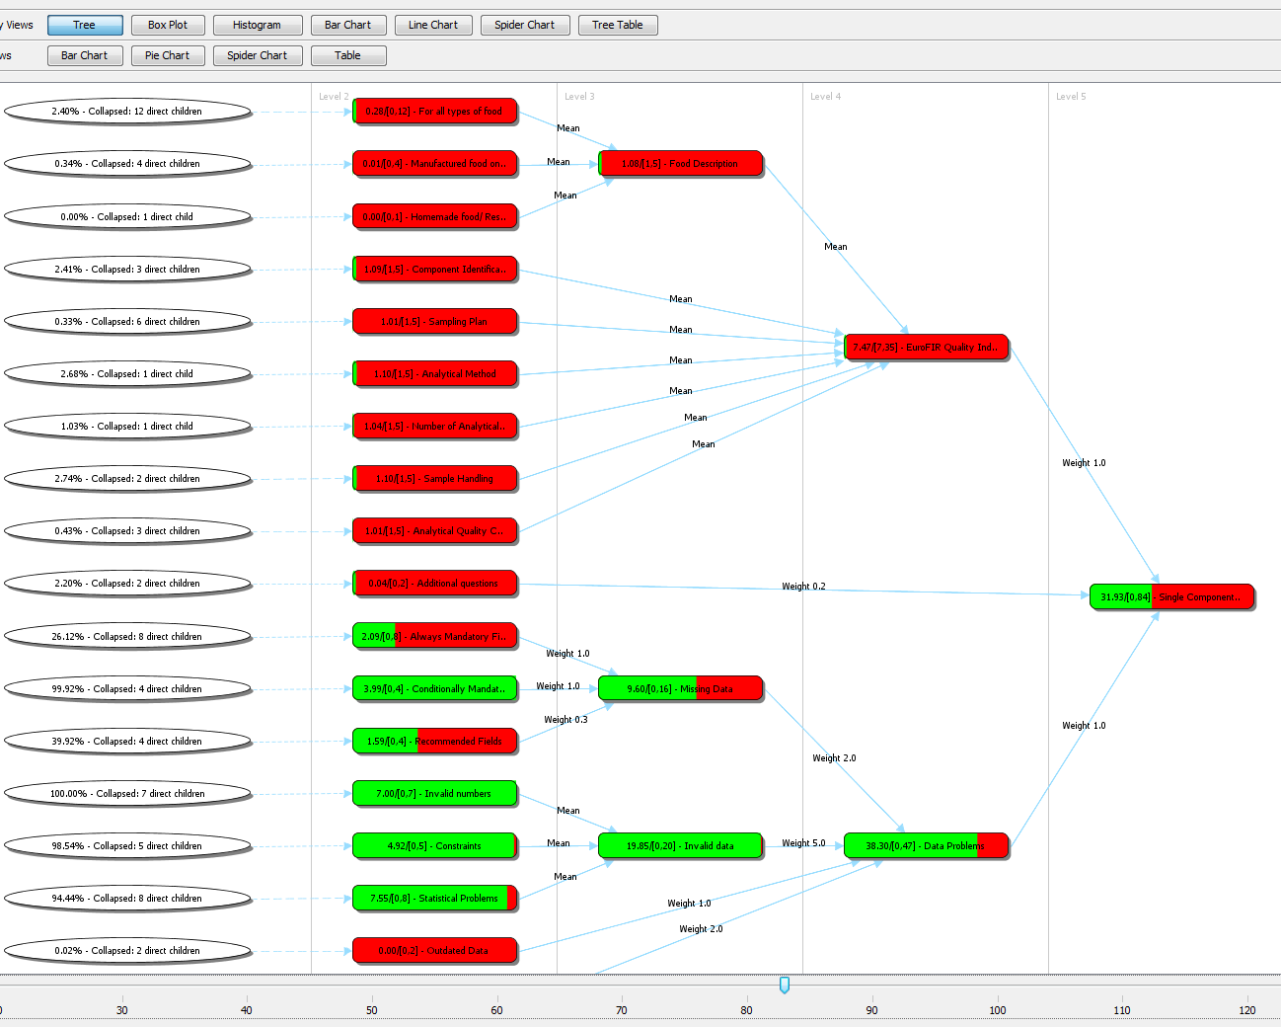
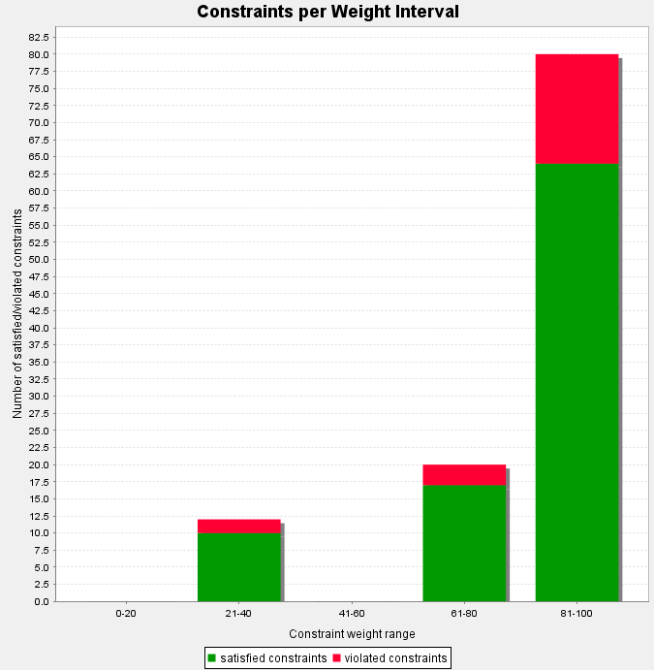
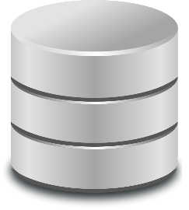

Data Quality Areas
Prevention of
low Data Quality
Data Quality Analysis
Data quality input validation & feedback
Data quality analysis & feedback

Slide 57
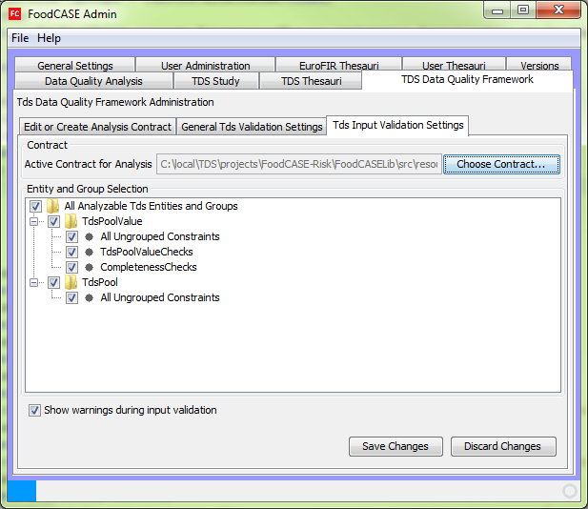
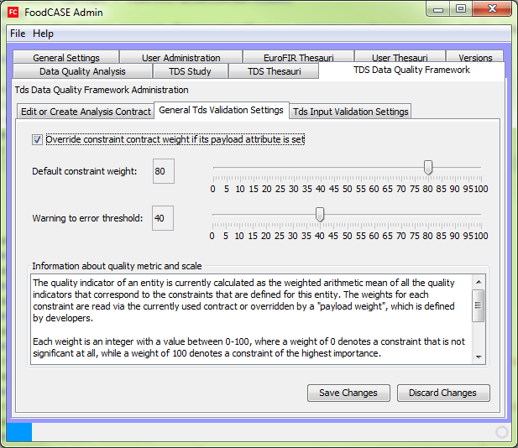
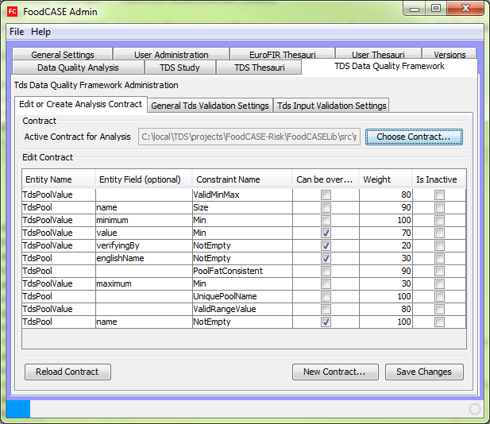
Data quality administration

Slide 58
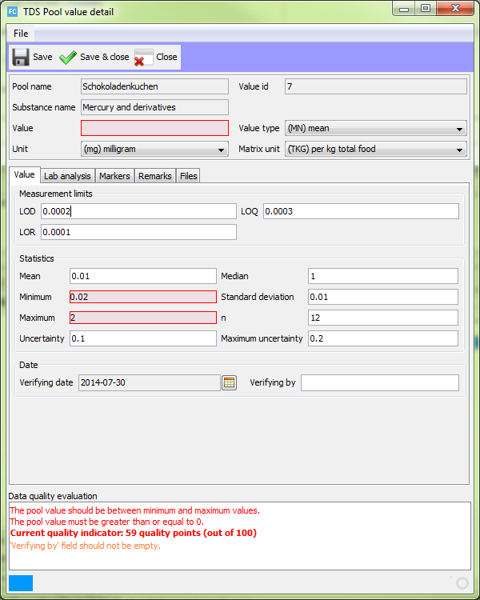
Data quality input validation

Slide 59
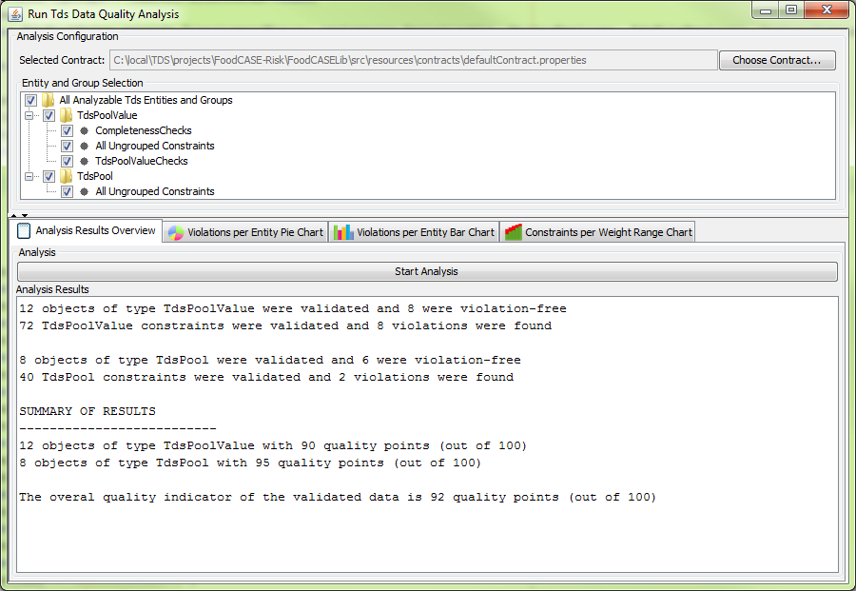
Data quality analysis

Slide 60
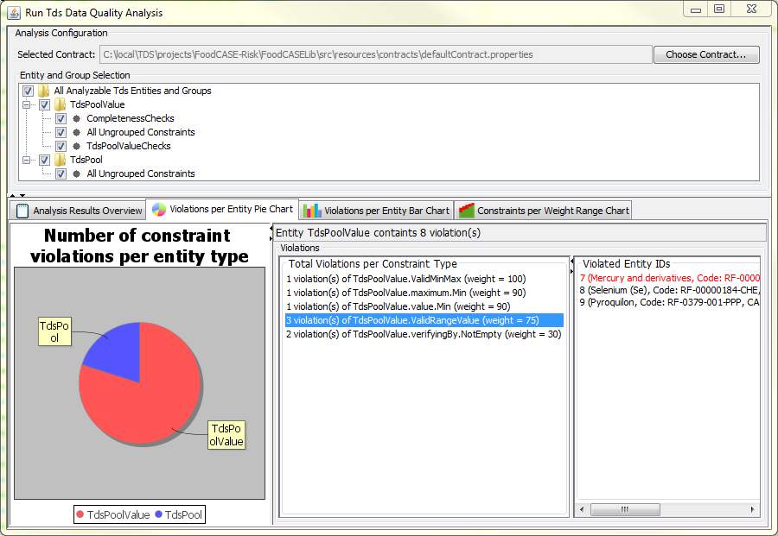
Data quality analysis

Slide 61
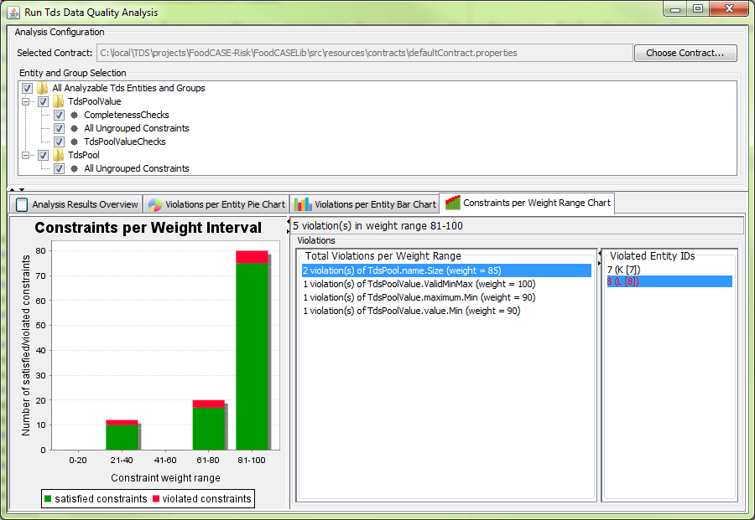
Data quality analysis

Slide 62
Data quality analysis

Slide 63

Outlook: European FoodCASE Infrastructure
UK
Germany
EuroFIR
Netherlands
TDS Exposure
Portugal
Switzerland

Slide 64
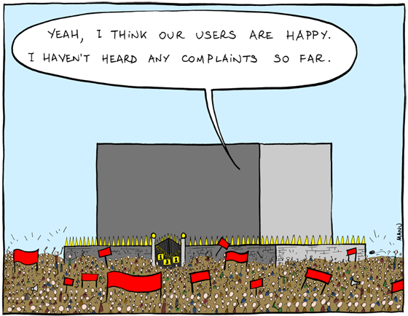
Your feedback / discussion
Thank you for your attention

