Slide 1
WP6/WP10 Workshop
Data Quality Framework
WP6/WP10 Workshop
Zurich, 13th February 2015
This project has received funding from the European Union’s Seventh Framework Programme
for research, technological development and demonstration (Grant Agreement no. 289108)

Slide 2
Agenda
Data Quality Framework (DQF) concept
  Constraints (rules) definition
  Contracts
Data input validation & data quality analysis
Measurement and calculation of data quality
Data quality visualisation
Comparison to Food Composition DQF
Your feedback / discussion
Survey
This project has received funding from the European Union’s Seventh Framework Programme
for research, technological development and demonstration (Grant Agreement no. 289108)

Slide 3
Data Quality Framework (DQF) concept
Managing and measuring data quality (DQ)
Constraints as DQ indicators
Unique definition and validation
Flexible and highly configurable DQF
  Importance weights for constraints
  Grouping of constraints
  DQ contracts for different users
  Various visualisations
This project has received funding from the European Union’s Seventh Framework Programme
for research, technological development and demonstration (Grant Agreement no. 289108)

Slide 4
DQF concept - Constraint definition
Constraints defined in a single place in the system (by developer)
Constraint groups can be defined (by developer)
  Constraints can belong to one or more groups
  Allow organising constraints into logical units (Constraint types, accuracy, completeness, etc.)
  Allow to validate/analyse only certain groups
This project has received funding from the European Union’s Seventh Framework Programme
for research, technological development and demonstration (Grant Agreement no. 289108)

Slide 5
DQF concept - Constraint definition cont.
No possibility to add new constraints or constraint groups for a user of the application
User can define weights and threshold
  0: Not important, 100: Most important
  Threshold between warning and error
  Default weight
Weights can be overwritten (if configured)
This project has received funding from the European Union’s Seventh Framework Programme
for research, technological development and demonstration (Grant Agreement no. 289108)

Slide 6
DQF concept - Contracts
A contract defines the weight (importance) for each of the constraints
A contract is a simple file (editable in GUI)
Default contract exists as fallback
Users can define their (multiple) own contracts
Contracts can easily be imported and shared between users
This project has received funding from the European Union’s Seventh Framework Programme
for research, technological development and demonstration (Grant Agreement no. 289108)

Slide 7
DQF concept - Example
Sample: Kartoffelsuppe (engl. Potato soup)
AnalysisValue: Total copper, 0.845 mg/kg
Two constraints:
  Sample.englishName.NotEmpty=80, active
  (very important)
  AnalysisValue.verifyingBy.NotEmpty=20, active
  (less important)
Other constraints: Min/Max, Range, Email, URL, Pattern, etc. and custom constraints (‘Was the subsample bought in the store as planned?’)
This project has received funding from the European Union’s Seventh Framework Programme
for research, technological development and demonstration (Grant Agreement no. 289108)

Slide 8
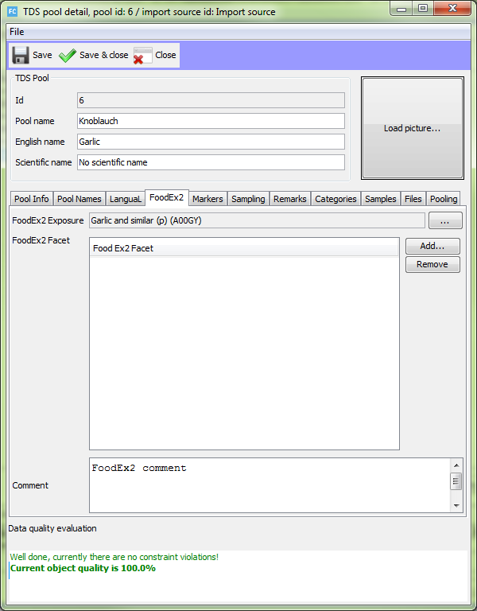
Data input validation
This project has received funding from the European Union’s Seventh Framework Programme
for research, technological development and demonstration (Grant Agreement no. 289108)

Slide 9
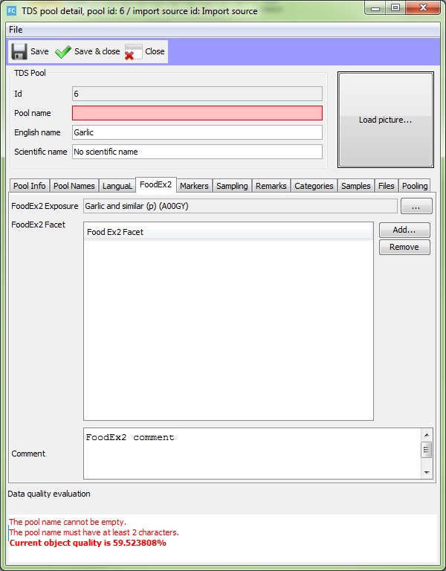
Data input validation
This project has received funding from the European Union’s Seventh Framework Programme
for research, technological development and demonstration (Grant Agreement no. 289108)

Slide 10
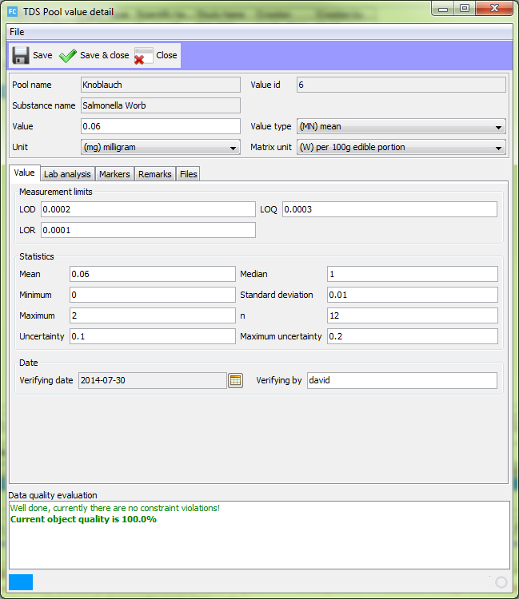
Data input validation
This project has received funding from the European Union’s Seventh Framework Programme
for research, technological development and demonstration (Grant Agreement no. 289108)

Slide 11
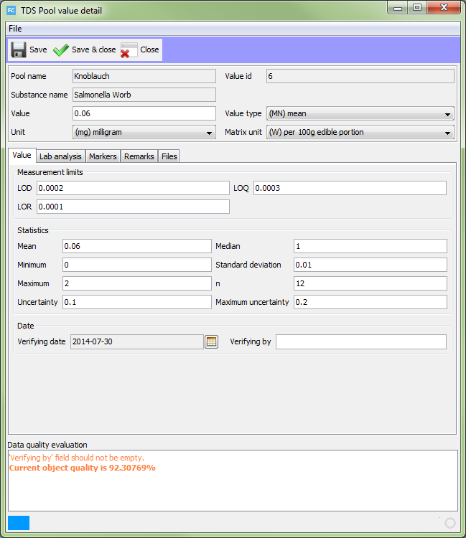
Data input validation
This project has received funding from the European Union’s Seventh Framework Programme
for research, technological development and demonstration (Grant Agreement no. 289108)

Slide 12
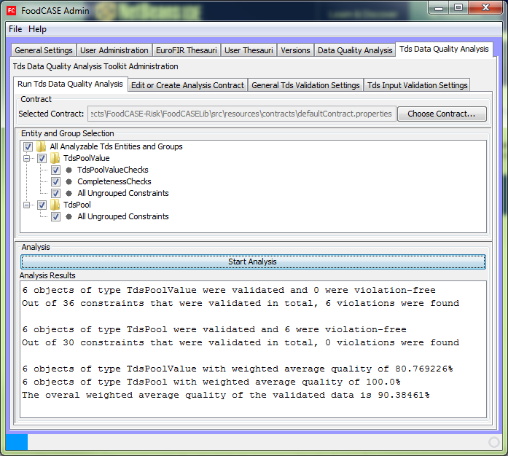
Data quality analysis
This project has received funding from the European Union’s Seventh Framework Programme
for research, technological development and demonstration (Grant Agreement no. 289108)

Slide 13
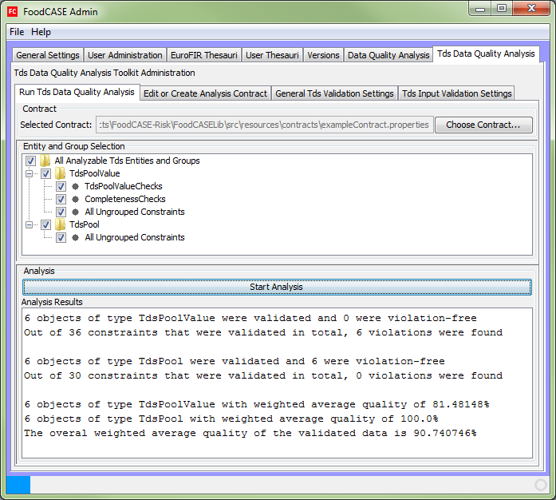
Data quality analysis
This project has received funding from the European Union’s Seventh Framework Programme
for research, technological development and demonstration (Grant Agreement no. 289108)

Slide 14
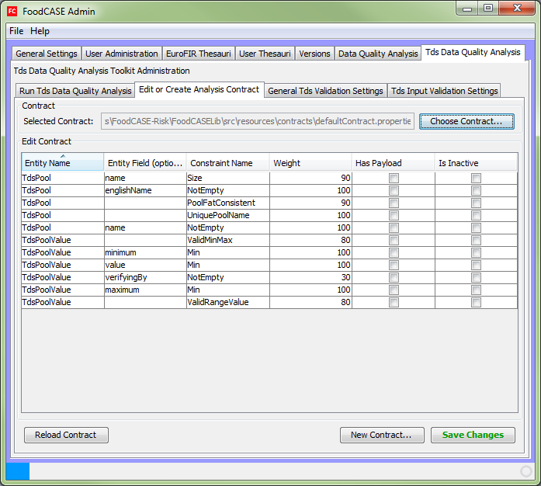
Data quality analysis
This project has received funding from the European Union’s Seventh Framework Programme
for research, technological development and demonstration (Grant Agreement no. 289108)

Slide 15
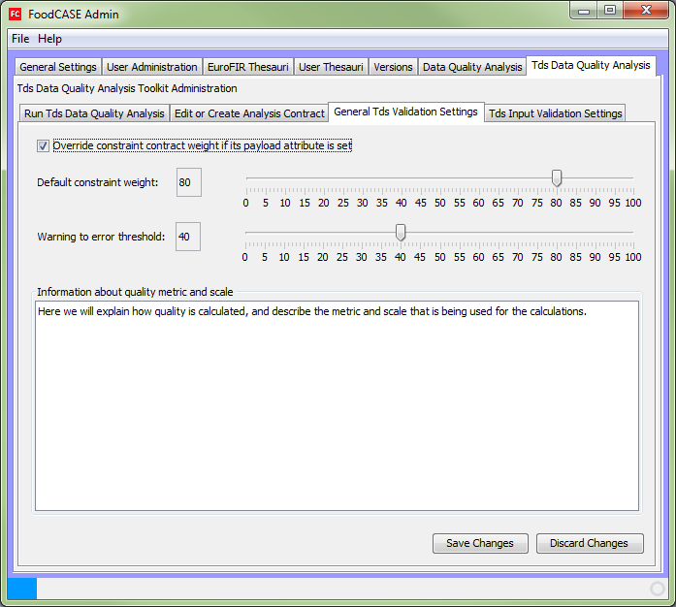
Data quality analysis
This project has received funding from the European Union’s Seventh Framework Programme
for research, technological development and demonstration (Grant Agreement no. 289108)

Slide 16
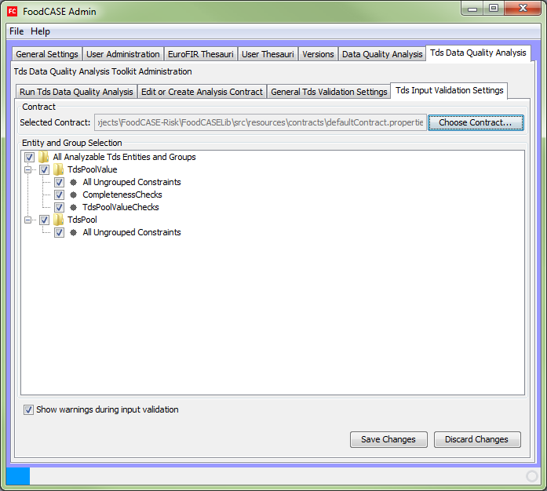
Data quality analysis
This project has received funding from the European Union’s Seventh Framework Programme
for research, technological development and demonstration (Grant Agreement no. 289108)

Slide 17
Data quality measurement / calculation
DQ is calculated as the weighted arithmetic mean of all DQ indicators
Other calculation schemes are possible but not implemented yet
Users cannot influence the calculation directly but indirectly by defining the constraint weights
This project has received funding from the European Union’s Seventh Framework Programme
for research, technological development and demonstration (Grant Agreement no. 289108)

Slide 18
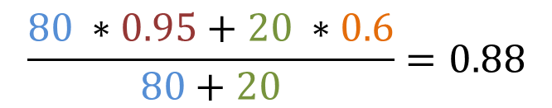
DQ calculation example
100 data entries, error threshold = 60
Constraint A (‘Sample English name not empty’), weight 80
Constraint B (‘Analysis value verified by not empty’) , weight 20
5 entities violating constraint A (quality indicator A: 0.95)
40 entities violating constraint B (quality indicator B: 0.60)
Overall entity quality indicator calculated as:
weight A
weight B
QI A
QI B
$$\frac{80 ∗0.95+20 ∗0.6}{80+20}=0.88$$
This project has received funding from the European Union’s Seventh Framework Programme
for research, technological development and demonstration (Grant Agreement no. 289108)

Slide 19
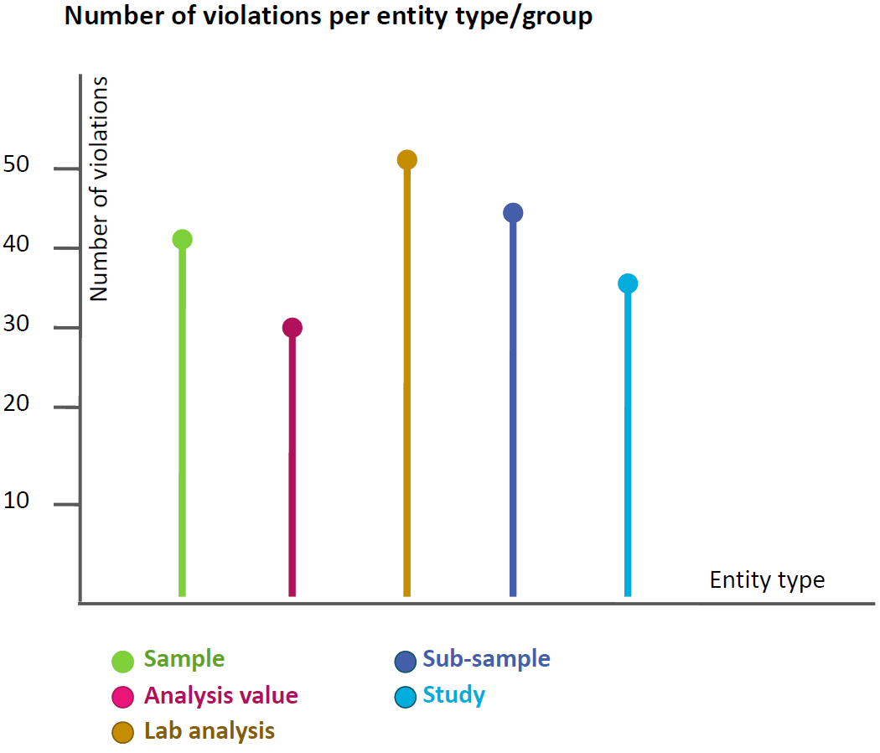
Data quality visualisation - Outlook
This project has received funding from the European Union’s Seventh Framework Programme
for research, technological development and demonstration (Grant Agreement no. 289108)

Slide 20
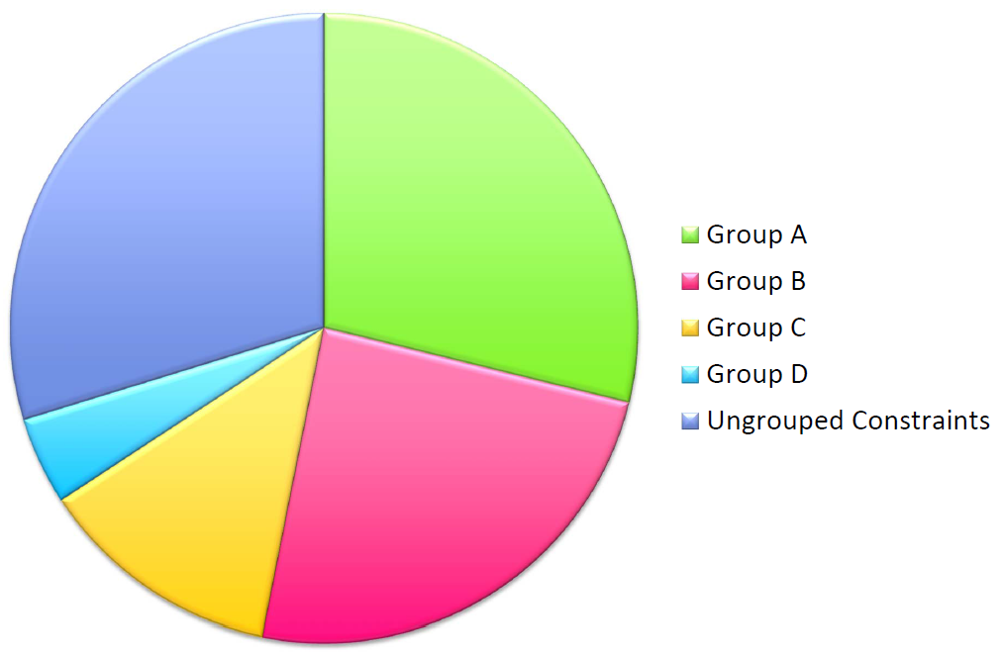
Data quality visualisation - Outlook
This project has received funding from the European Union’s Seventh Framework Programme
for research, technological development and demonstration (Grant Agreement no. 289108)

Slide 21
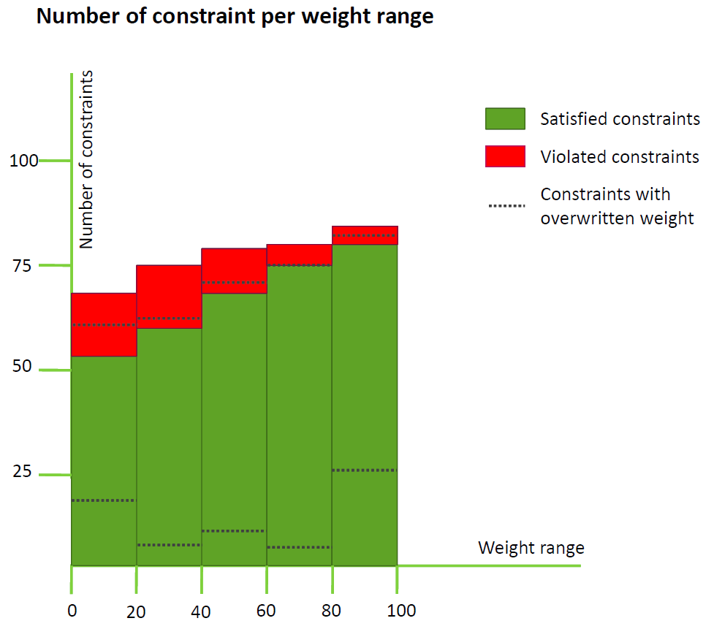
Data quality visualisation - Outlook
This project has received funding from the European Union’s Seventh Framework Programme
for research, technological development and demonstration (Grant Agreement no. 289108)

Slide 22
Data quality visualisation - Outlook
25 violations of constraints with weight in the range of 80-100
10 violations of TdsPool.PoolFatConsistent (weight=80)
5 violations of TdsPool.englishName.NotEmpty (weight=80)
5 violations of TdsPoolValue.MinMaxValue (weight=90)
3 violations of TdsPoolValue.Value.NotEmpty (weight=100)
2 violations of TdsPoolValue.maxValue.Min (weight=100)
The maximum analysis value must be equal or larger than 0
This project has received funding from the European Union’s Seventh Framework Programme
for research, technological development and demonstration (Grant Agreement no. 289108)

Slide 23
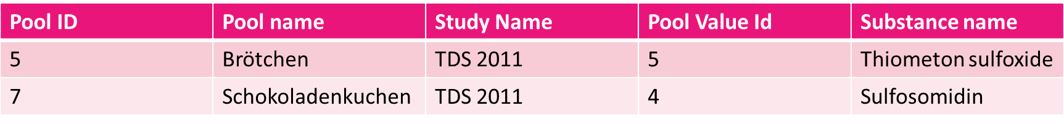
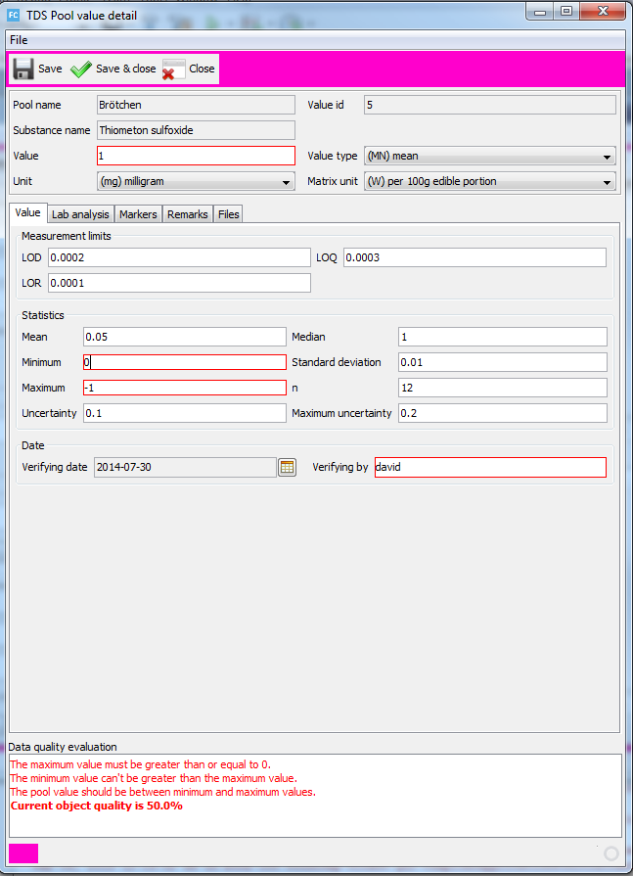
Data quality visualisation - Outlook
This project has received funding from the European Union’s Seventh Framework Programme
for research, technological development and demonstration (Grant Agreement no. 289108)

Slide 24
Comparison to Food Composition DQF
Input validation and DQ analysis
  based on contracts (configurable individual importance weights per contract/user/user group)
  user has influence on what is validated/measured
  → entities, groups
  user has influence on the importance of constraints also for the input validation
  Additional DQ feedback of importance (%)
This project has received funding from the European Union’s Seventh Framework Programme
for research, technological development and demonstration (Grant Agreement no. 289108)

Slide 25
Comparison to Food Composition DQF
Constraints
  Constraints can be set as inactive
  Configuration of default weight/importance
  Configuration of warning error threshold
  Warnings can be disabled
Visualisation is open
This project has received funding from the European Union’s Seventh Framework Programme
for research, technological development and demonstration (Grant Agreement no. 289108)

Slide 26
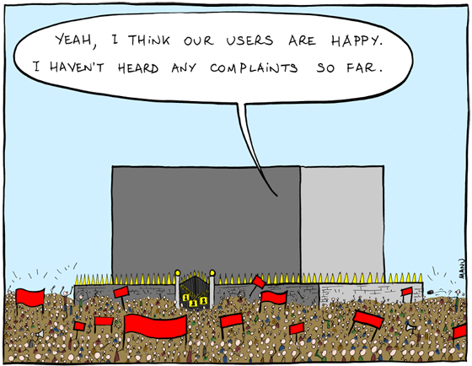
Your feedback / discussion
This project has received funding from the European Union’s Seventh Framework Programme
for research, technological development and demonstration (Grant Agreement no. 289108)

Slide 27
Survey
Please fill out all questions if possible
Don’t hesitate to ask if something is unclear
If you have additional comments, ideas or requirements (such as a different DQ calculation) please let us know at the end of the questionnaire
Time: 45 min
Additional online survey for attributes planned
This project has received funding from the European Union’s Seventh Framework Programme
for research, technological development and demonstration (Grant Agreement no. 289108)

Slide 28
Thank you for your participation and attention
This project has received funding from the European Union’s Seventh Framework Programme
for research, technological development and demonstration (Grant Agreement no. 289108)

