Slide 1


FoodCASE-Risk in the context of food data
David Weber (ETH Zurich)
TDS-Exposure Summer School, Helsinki, 9th of July 2015

Slide 2
David Weber
MSc in Computer Science with focus on information systems and business informatics
Several years of work experience as software engineer in the financial industry
PhD student at ETH Zurich
3 years experience with food composition and TDS data management system
Research interest on data quality

Slide 3
Outline
Why to manage TDS data
What data needs to be managed
How data needs to be managed
Architecture and food data entities
Use cases in FoodCASE
Data quality in FoodCASE
[Concepts for data management ]

Slide 4
Why to manage TDS data?

Slide 5
Why to Manage TDS Data
Preserve data for long-term access
Enhance data security
Minimise risk of data loss
Save time and resources in long run
Enable other to access your data (unique way)
Increase the visibility of your work
Facilitate new discoveries

Slide 6
Why to Manage TDS Data
Meet grant requirements
See data as a product for which funding were used
Open data means that publicly funded data must be publicly available (EU directive)

Slide 7
Take Home Message I
TDS data is the output of your work and your asset.
Take care of it.

Slide 8
What Data Needs to be Managed?

Slide 9



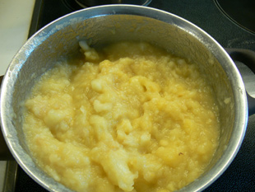
How does a TDS work?
Food 1
Food 2
Food 3
…
Food A
Food B
Food C
…
prepare as consumed
Food A
Food B
Food C
…
pool
plan
Pooled food X
Collect food according to consumption info

Slide 10


How does a TDS work?
Nutrient values
Contaminant values
Pooled food X
Recommendation
analyse
Assess risk

Slide 11
Management of TDS Data
Preparation information
Sampling information
Pooling information
Food information
Analysis information
TDS Data Repository
Substance value information
Consumption information

Slide 12
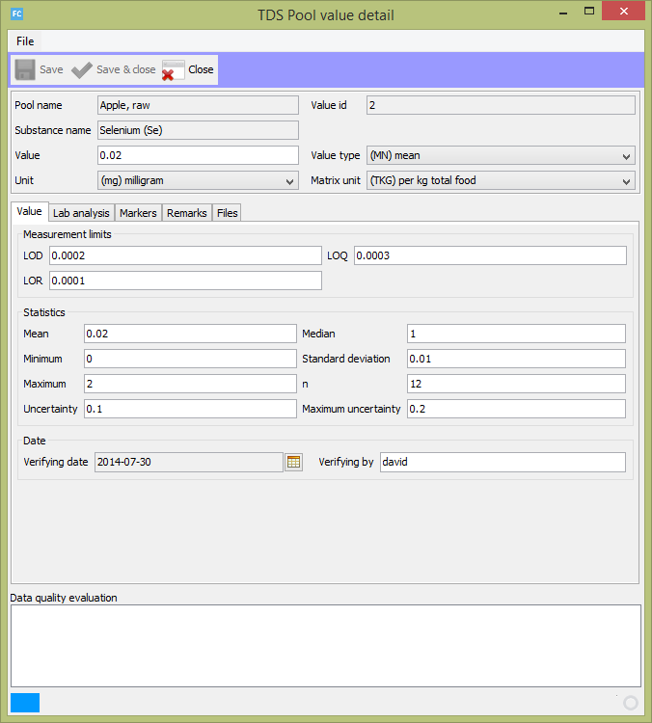

Slide 13
Take Home Message II
Value documentation is crucial for scientific evidence.

Slide 14
What Data Needs to be Managed?
Until now every country did its own TDS and collected data according to their requirements
One goal in the TDS-Exposure project is to establish recommendations what data should be collected

Slide 15
What Data Amount Needs to be Managed?
The following numbers were identified:
200 foods
96 attributes per food and
49 for one substance value
Example:
200 food items with about 10 substances
-> at least 117’200 data points

Slide 16
Linkage of Food Items
Food Compilation Application
Food Composition
Food Consumption
Total Diet Study
Food Name
Apple, fresh
Pear, fresh
Person
Person1
Person2
Food Name
Apple, fresh
Pear, fresh
Component | Value
Protein | 0.3g/100g
Vitamin C | 5mg/100g
Food | Amount
Apple, fresh | 1 piece
Pear, fresh | 1 piece
Component | Value
Mercury | 0mg/100g
Selenium | 0mg/100g

Slide 17
Take Home Message III
Use a feasible tool to manage your TDS and make your data sustainable.

Slide 18
How Data Needs to be Managed?

Slide 19
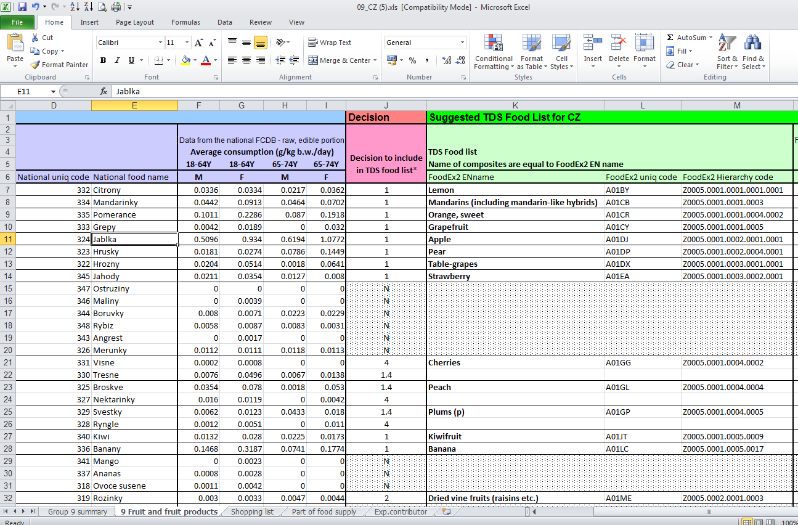

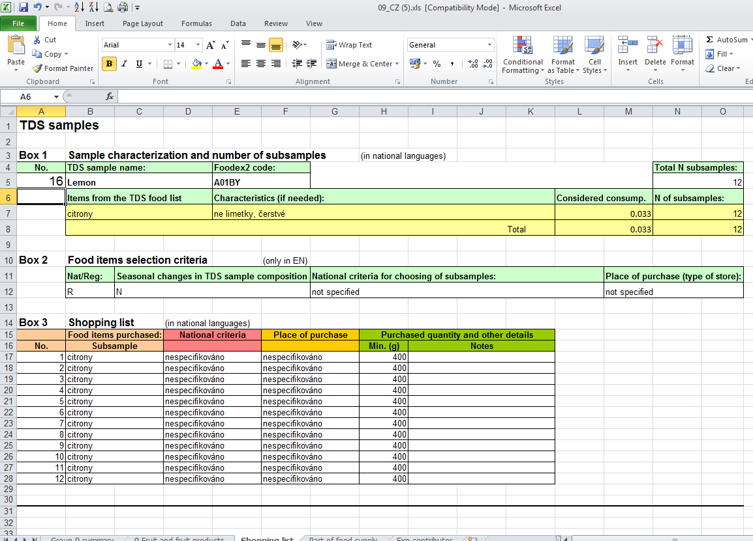

How to Work with a TDS Data Management System?
Assemble food list
Different data sets are needed: food comp data, consumption data and former TDS data
Assemble shopping list
Planning Phase
EXCEL is a handy tool to manipulate multiple entries.
Issue: 18 EXCEL files (one for each food category)
Form pool groups
t

Slide 20

How to Work with a TDS Data Management System?
Collect food items
Prepare samples
Execution Phase
Form pool groups
Only deviation from original plan must be documented.
Analyse food items
t

Slide 21
How to Work with a TDS Data Management System?
LIMS
Enter substance values
Lab Analysis Phase
Archive data
Export data for risk assessment
t

Slide 22
Take Home Message IV
A good TDS data management system does not restrict you in your TDS approach. It rather supports your value documentation and risk assessment.

Slide 23
Architecture and Food Data Entities

Slide 24
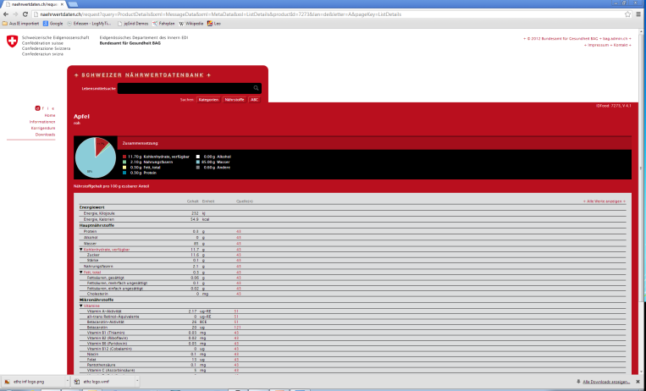
Architecture of a Food Information System
Database
Web Level
Database Level
Web Services
Server Level
Application Server
Web Server Component
Graphical User Interface (GUI) Level
Food Data Application
Food Composition Data
TDS Data
Admin Application
User Admin
Food Consumption Data
Reference
Thesauri
Marker
Data Quality Prevention
Data Quality Analysis
…

Slide 26
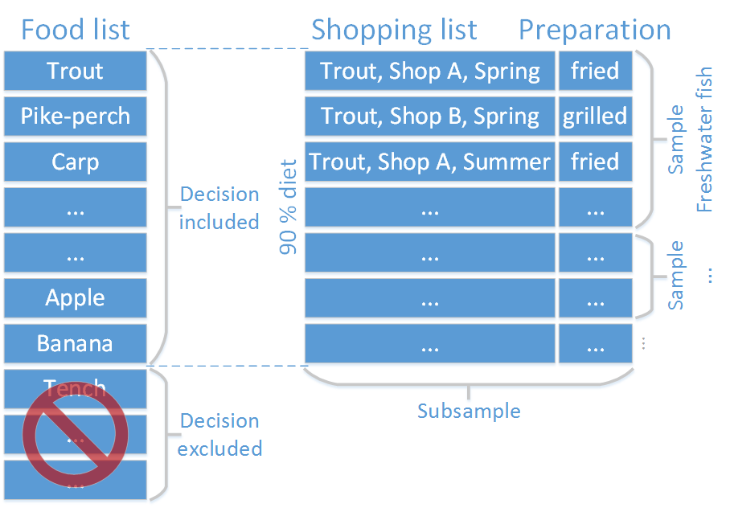

Slide 27
Use Cases in FoodCASE

Slide 28
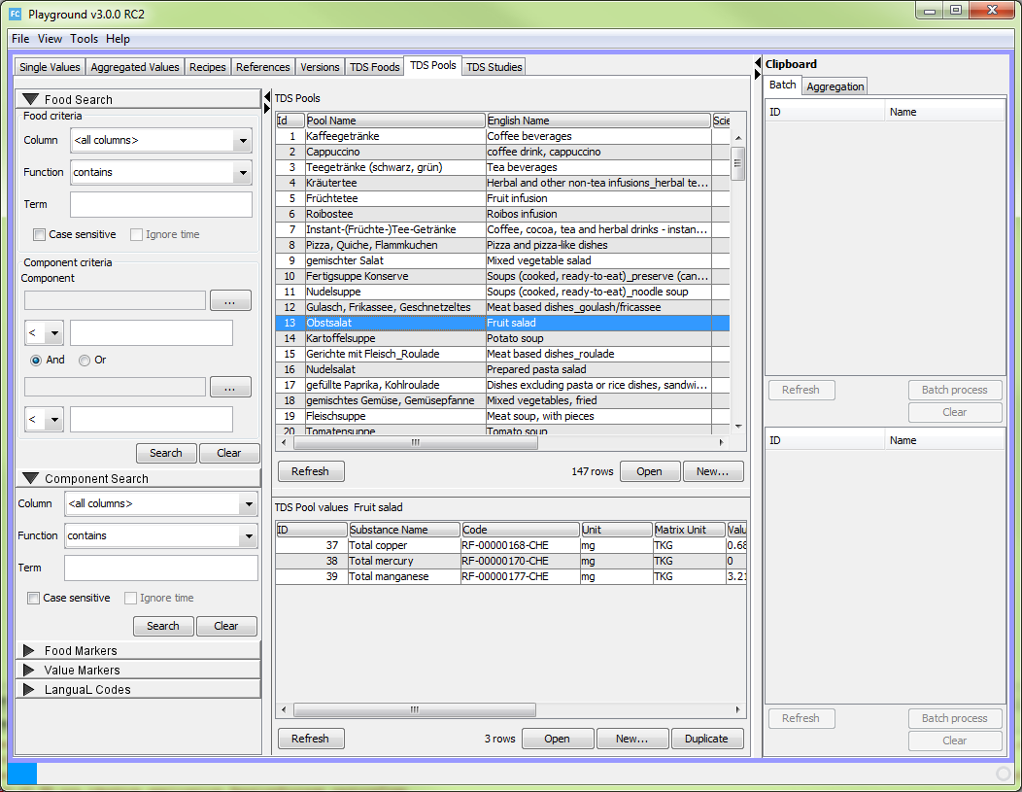
Starting Mask - Overview
Search Area
Data Listing Area
All or certain columns
Content of substances
Data markers
LanguaL / FoodEx2 codes
Food / Sample items
Analytical results
(beneficial and
harmful substances)

Slide 29
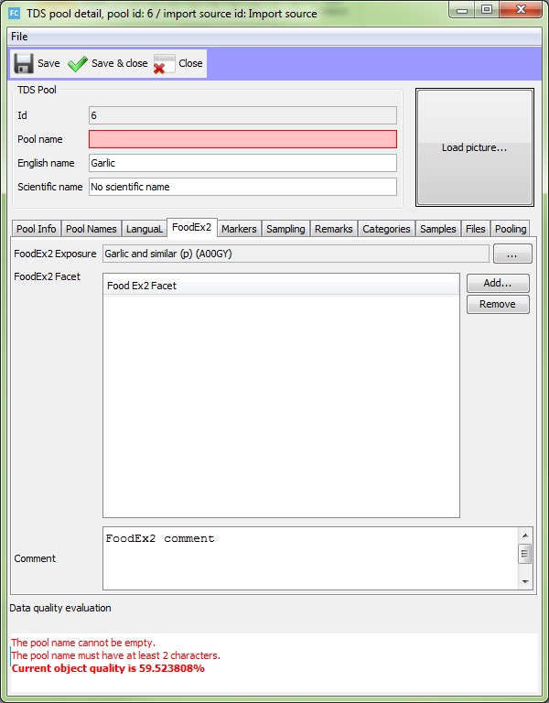
Managing Sample
Mandatory fields
Many other attributes for a sample
Data quality panel

Slide 30
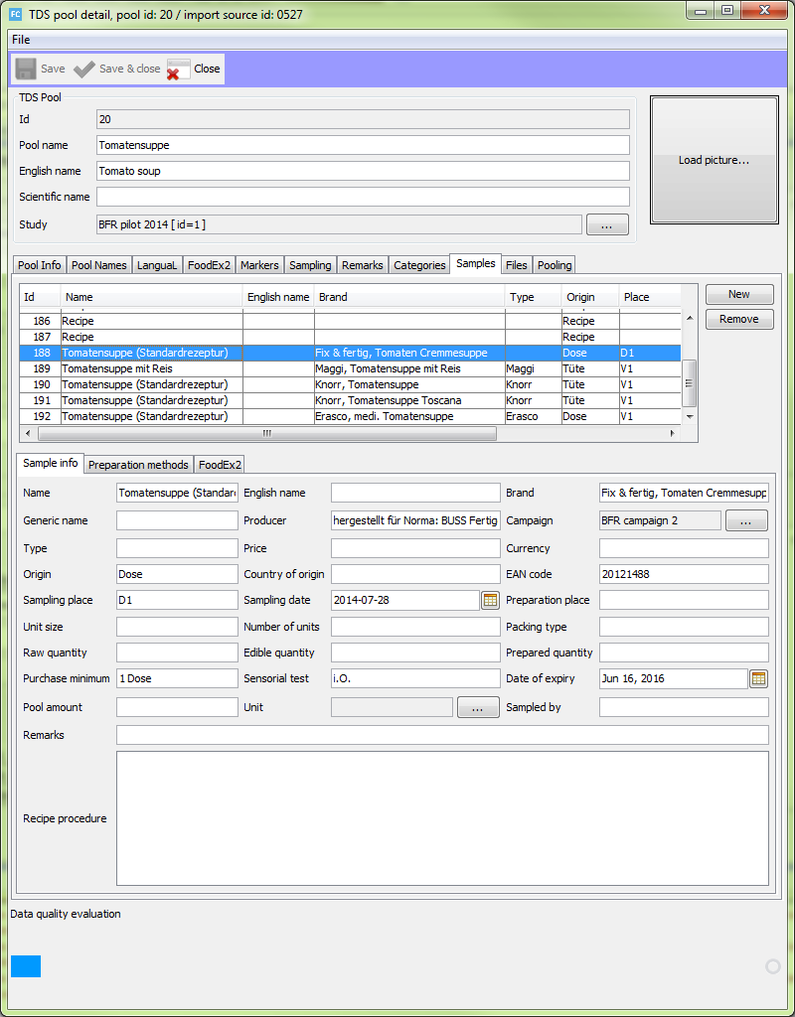
Managing
Subsamples
Attribute values depending on the table selection

Slide 31
Managing Analysis Results
Laboratory report
Other scientific publication
Basic idea:
Provide as much value documentation as possible
Attach original published document

Slide 32
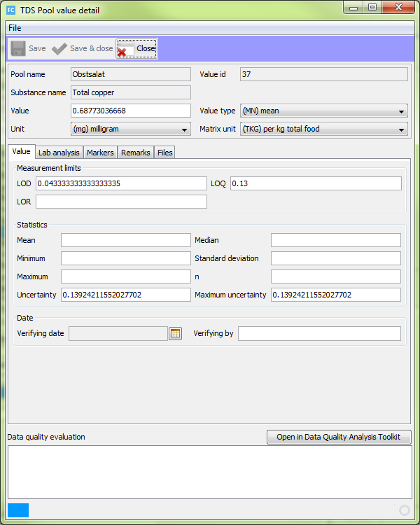

Managing Analysis Results
Many available attributes
Data quality panel

Slide 33
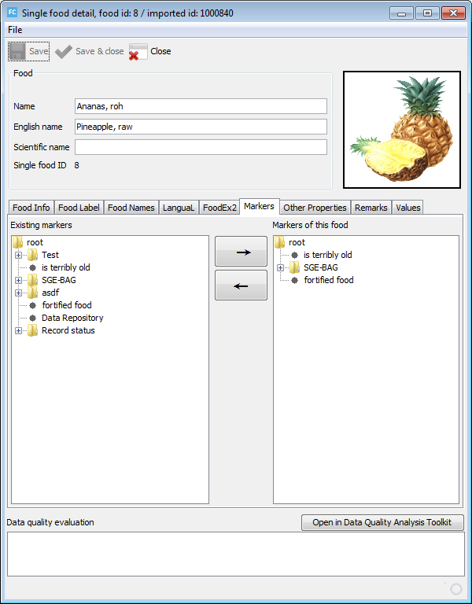
Markers
Available markers
Assign or remove from current entity
Definition of markers in the Admin client
Custom naming
Multilevel markers for TDS

Slide 34
Take Home Message V
FoodCASE contains all necessary concepts and its user interfaces are simple structured and intuitive.

Slide 35
Data Quality in FoodCASE

Slide 36
Data Quality (DQ)
Definitions of data quality:
Data or information has quality if it is appropriate for the intended use
The quality of data or information depends on users’ expectations and requirements

Slide 37
Data Quality Requirement (DQR)
A data quality requirement is a concrete intrinsic or contextual constraint to data that helps to satisfy an aspect or construct of data quality.

Slide 38
Data Quality Requirements
Food name must be unique
Analytical results should not be older than 10 years
Sample should have at least analytical results for mercury and selenium
Rating
Rating
Rating
W=10
W=100
W=60
Data Quality
Rating

Slide 39
Data Quality Framework (DQF) concept
Managing and measuring data quality (DQ)
Constraints as DQ indicators
Unique definition and validation
Flexible and highly configurable DQF
  Importance weights for constraints
  Grouping of constraints
  DQ contracts for different users
  Various visualisations

Slide 40
DQF Weights & Contracts
User can define weights and threshold
  0: Not important, 100: Most important
  Threshold between warning and error
  Default weight
A contract defines the weight (importance) for each of the constraints
Default contract exists as fallback
Users can define their (multiple) own contracts
Contracts can easily be imported and shared

Slide 41
Types of DQ Requirements
Food name must be unique
Hard constraints → Error
Determines if data is deficient or not
Soft constraints → Warning
The more requirements are satisfied, the better is data quality
Indicators → Warning
Indicate better quality but quality improvement is not evident
Sample should have at least analytical results for mercury and selenium.
Analytical results should not be older than 10 years

Slide 42
Data Quality Rating
Can be simple as ‘satisfied’ or ‘not satisfied’ or more complex, for instance 0 to 100
Can be defined by user
Food name must be unique
Rating

Slide 43
DQF constraints & weighting - Example
Sample: Kartoffelsuppe (engl. Potato soup)
AnalysisResult: Total copper, 0.845 mg/kg
Two constraints:
  Sample.englishName.NotEmpty=80, active
  (very important)
  AnalysisResult.verifyingBy.NotEmpty=20, active
  (less important)
Other constraints: Min/Max, Range, Email, URL, Pattern, etc. and custom constraints (‘Was the subsample bought in the store as planned?’)

Slide 44

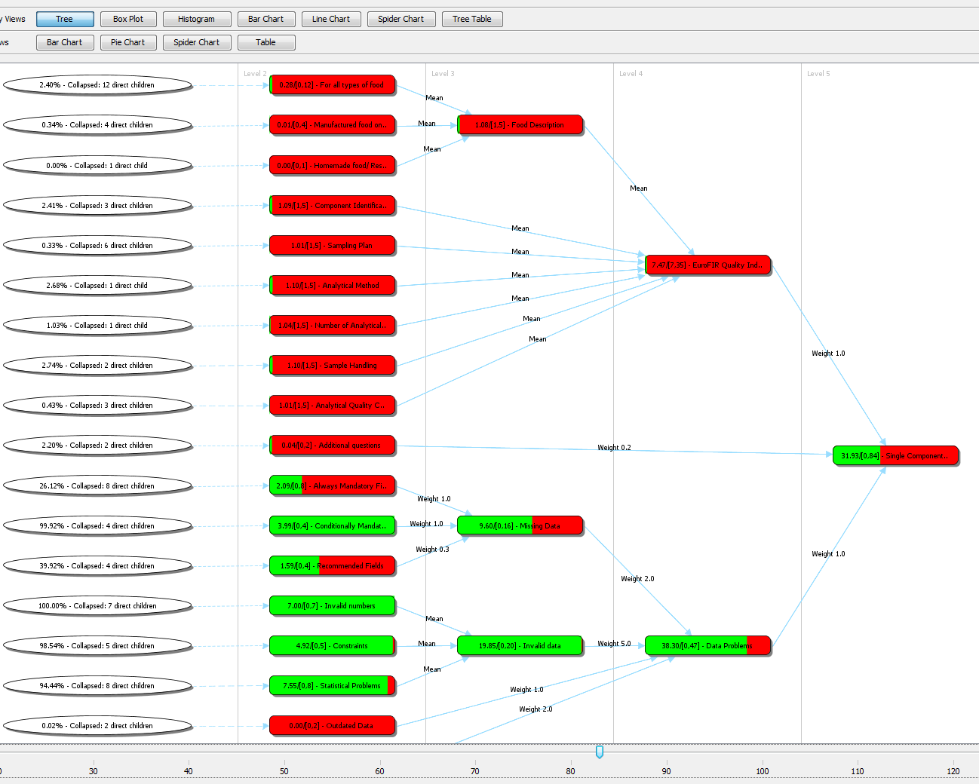
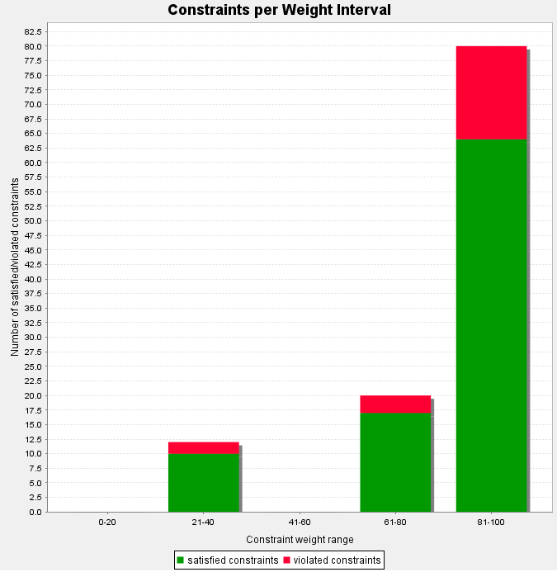


Data Quality Areas
Prevention of
low Data Quality
Data Quality Analysis
Data quality input validation & feedback
Data quality analysis & feedback

Slide 45
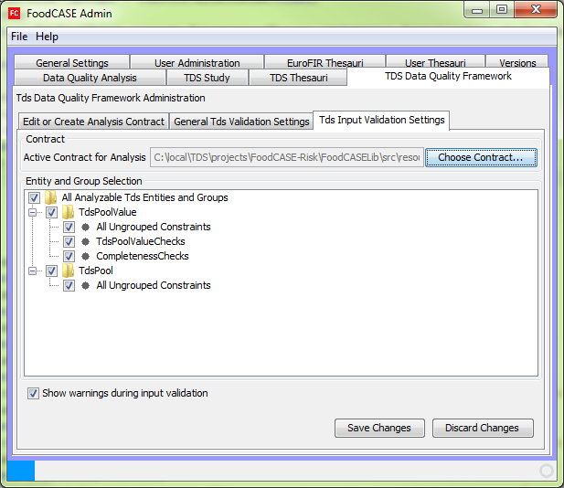
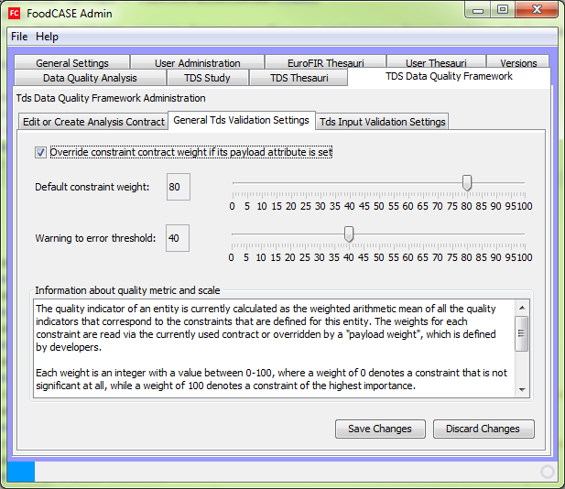
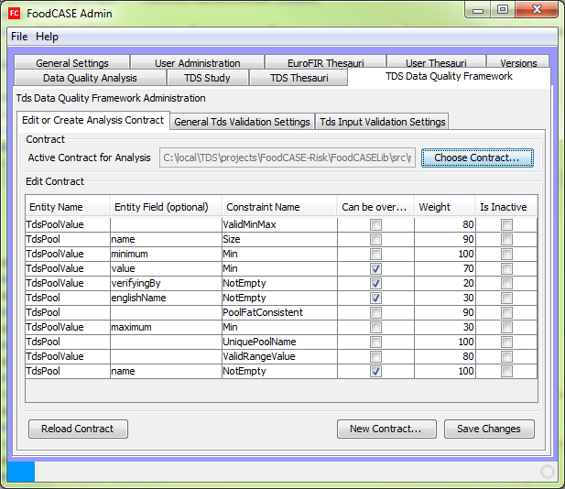
Data quality administration

Slide 46
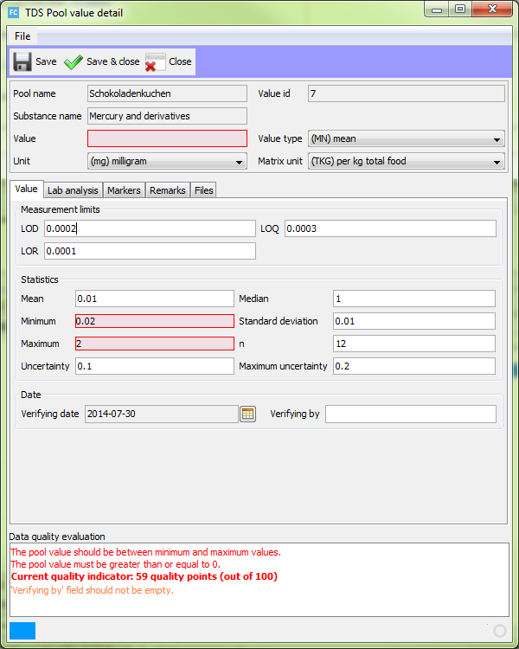
Data quality input validation

Slide 47
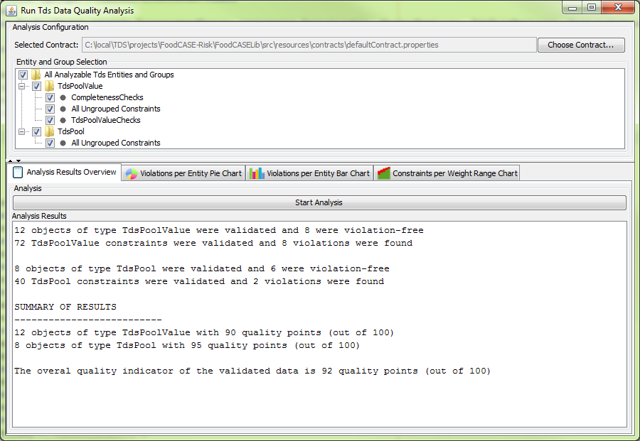
Data quality analysis

Slide 48
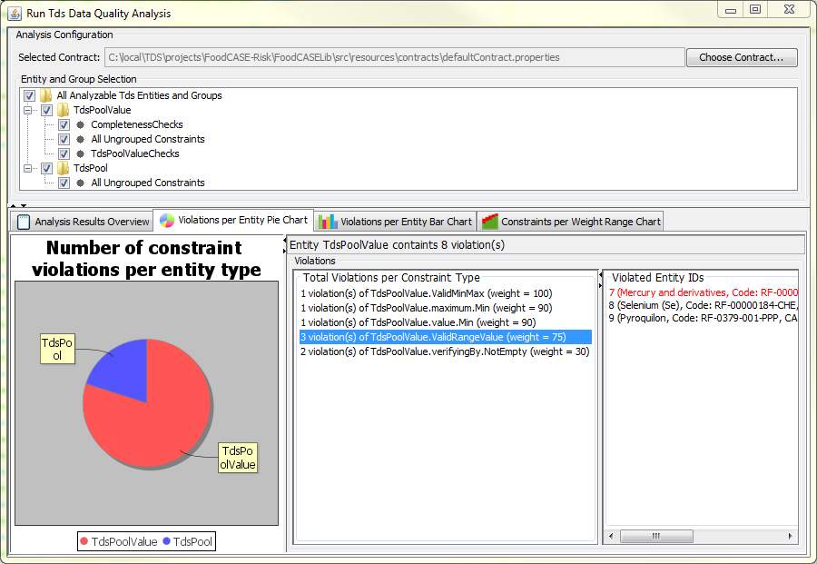
Data quality analysis

Slide 49
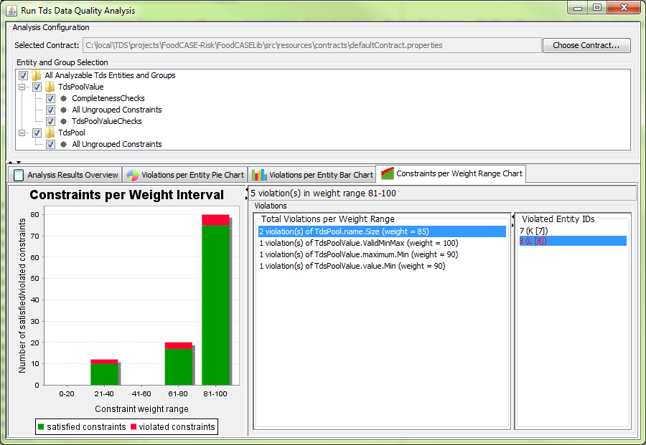
Data quality analysis

Slide 50
Data quality analysis

Slide 51
Take Home Message VI
Data quality requirements can differ dependent on the utilisation of data. Thus, a flexible feedback is necessary.

Slide 52
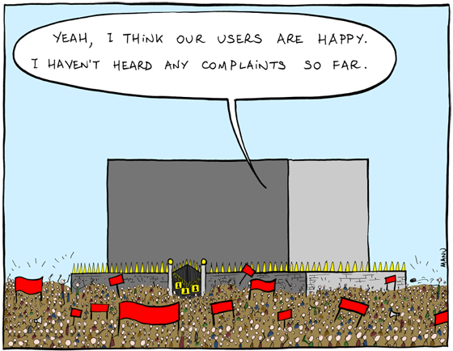
Your feedback / discussion
Thank you for your attention

Slide 53
Concepts for Data Management

Slide 54

TDS Data Markers
Concept 1:
Add information to data which is unlimited,
user-defined and semantical
Apple, fresh
TDS 2008
Patulin source
(mycotoxine)
Most often consumed food

Slide 55
TDS Data Markers
Concept 2:
Structure markers to simplify overview
TDS
Fortified
TDS 2008
with Vit C
TDS 2012
with Vit D

Slide 56
TDS Data Markers
Concept 3:
Markers are searchable
Search food items which were not used in the TDS 2008
but in TDS 2010
and are fortified with vitamin C
“TDS 2008” AND NOT “TDS 2010” AND “fortified with vit C”

Slide 57
Take Home Message
Markers is a flexible concept for semantical data tagging.

Slide 58
Reports and Exports of TDS Data
Reporting/Exporting means
to search and prepare existing data,
to bring it into a usable form such as table or graphic,
and to put it into a human or computer readable file format such as PDF or EXCEL

Slide 59
Reports and Exports of TDS Data
Challenge: Reports are useful but exist in endless number of variations and implementation costs.
Solution:
Data must be selectable for use in report/export
User should be able to define their own reports in terms of form and format

Slide 60
Take Home Message
Report and export functionalities should satisfy needs and in best case can be extended by users.

Slide 61
Data quality measurement / calculation
DQ is calculated as the weighted arithmetic mean of all DQ indicators
Other calculation schemes are possible but not implemented yet
Users cannot influence the calculation directly but indirectly by defining the constraint weights

Slide 62
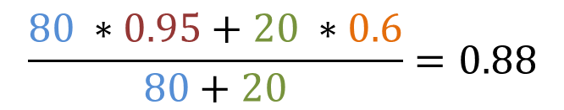
DQ calculation example
100 data entries, error threshold = 60
Constraint A (‘Sample English name not empty’), weight 80
Constraint B (‘Analysis value verified by not empty’) , weight 20
5 entities violating constraint A (quality indicator A: 0.95)
40 entities violating constraint B (quality indicator B: 0.60)
Overall entity quality indicator calculated as:
weight A
weight B
QI A
QI B
$$\frac{80 ∗0.95+20 ∗0.6}{80+20}=0.88$$

Slide 63
Comparison to Food Composition DQF
Input validation and DQ analysis
  based on contracts (configurable individual importance weights per contract/user/user group)
  user has influence on what is validated/measured
  → entities, groups
  user has influence on the importance of constraints also for the input validation
  Additional DQ feedback of importance (%)

Slide 64
Comparison to Food Composition DQF
Constraints
  Constraints can be set as inactive
  Configuration of default weight/importance
  Configuration of warning error threshold
  Warnings can be disabled
Visualisation is open

