Slide 1
How to Give Feedback on
Data Quality:
A Study in the Food Sciences
David Weber, Karl Presser, & Moira Norrie (ETH Zurich)
Notes:
Hello everybody.
I welcome you to my presentation of ‘How to Give Feedback on Data Quality: A Study in the Food Sciences’.
My name is David Weber and I am a PhD student at the ETH Zurich in Switzerland.
The work I present here is one step in a larger project where we want to explore how data quality can be measured and how can the appropriate feedback be presented to users.
At this point I also want to thank Karl Presser and Moira Norrie for the opportunity to write a paper together with them.
The work was financially supported by the European FP7 programme as part of the TDS-Exposure project.
We want to thank Reto Mock for his work that contributed to the DQ analysis toolkit and the participants of the TDS-Exposure project for their support.
Presenter guidelines:
Ideally, presentations should make the motivation of the research clear, as well as highlight the research question(s), the central argument/theories, the key findings and the paper’s contributions. Also, making key points and sharing key insights early in the presentation will ensure that the audience hear them and that they will not be inadvertently lost when the presenter runs out of time.

Slide 2
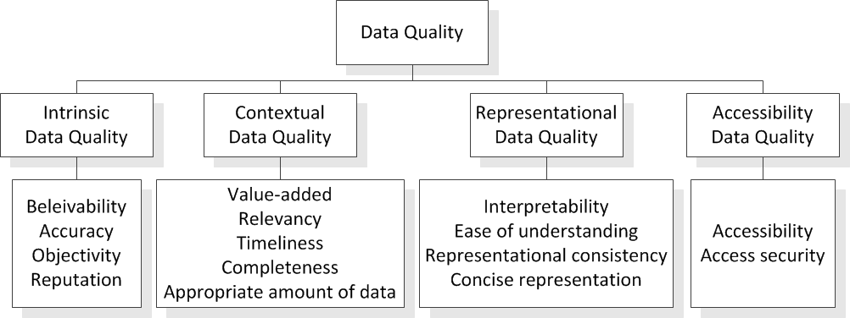
Data Quality (DQ)
Fitness for use
Critical issue in scientific databases
Data quality (DQ) dimension for the various aspects
DQ framework by Wang and Strong
Lack of general tools, mechanisms and metrics
Notes:
Since our paper is strongly related to data quality and food science data I will first give a short overview of those topics.
There exist a lot of definitions of Data Quality but the most common is still that it is the «Fitness for use». Which means that data of high quality has to represent the real-world items as adequate and correct as possible and that it should be appropriate for the intended use.
Data quality is a critical issue in scientific databases since the reliability of empirical data can have a major impact on the formation of scientific theories and policy decisions.
Efforts have been made to define DQ in terms of a wide variety of DQ dimensions each of which captures a specific aspect of data quality such as accuracy or completeness and contributes to a measure of the overall data quality.
There exist a lot of different conceptual frameworks for DQ which define different DQ dimensions and organise them in several categories. One of the most known conceptual frameworks for DQ is from Wang and Strong which is shown here at the bottom of the slide. You can see the different dimensions such as Accuracy and Completeness in the lower part that are categorised for example in Intrinsic or Contextual DQ.
Although several conceptual frameworks for DQ have been proposed, there is still a lack of general tools, mechanisms and metrics to measure and control the quality of empirical data in information systems beyond typical constraints for checking syntactic correctness, consistency and completeness.

Slide 3
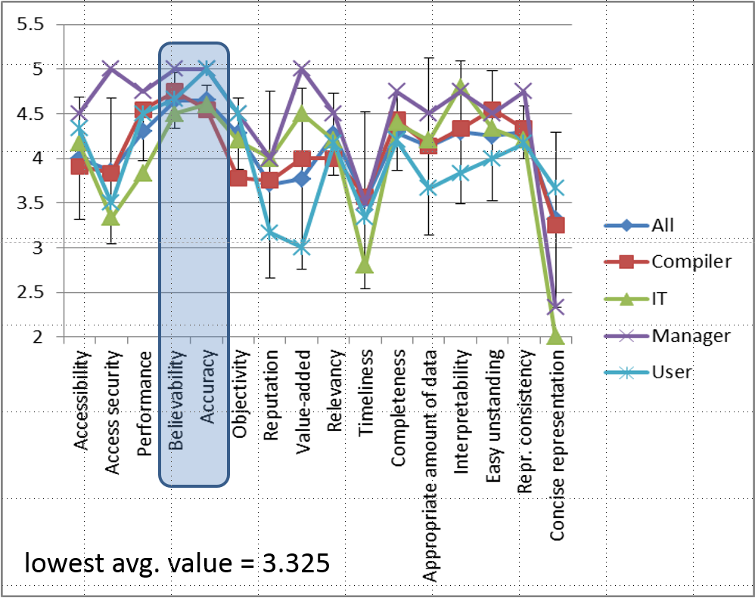
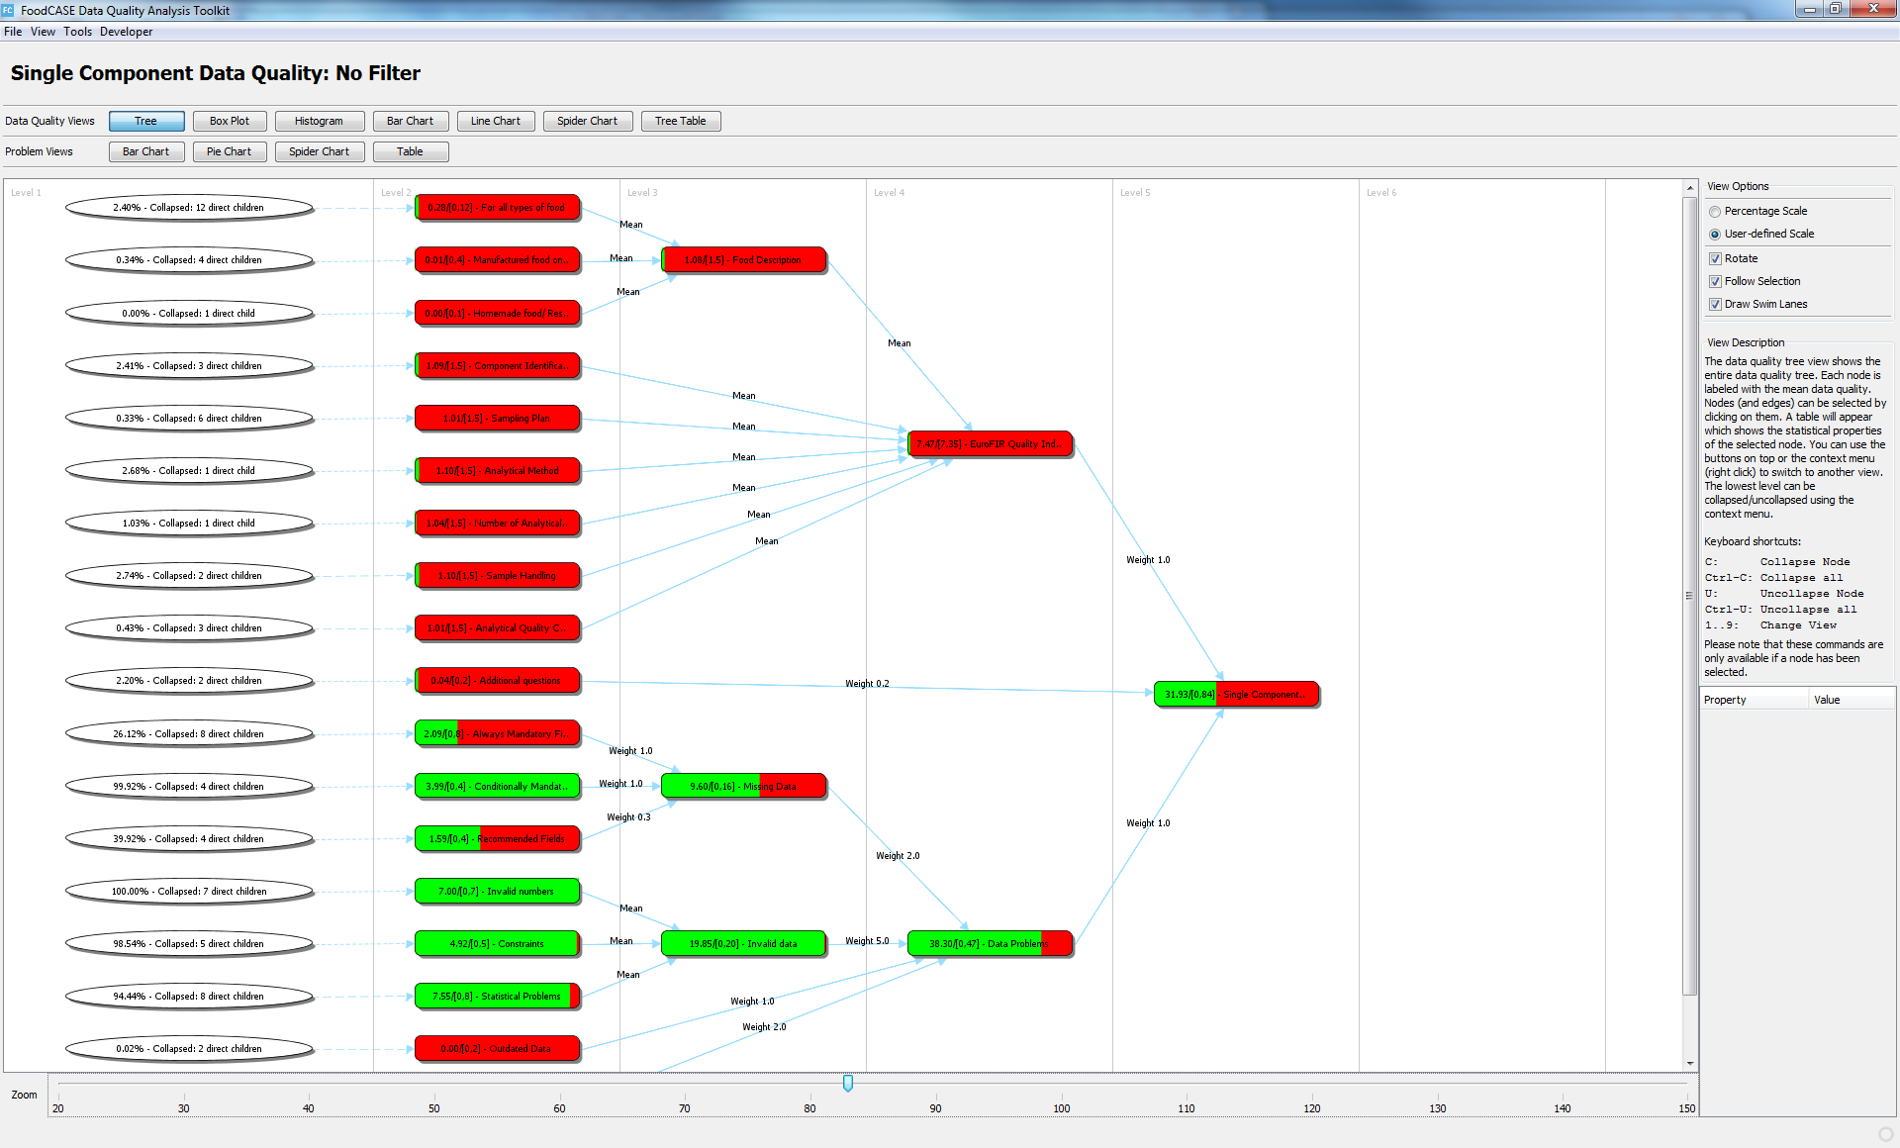
Overview
Long-term goal: general DQ framework
→ Visual access to DQ metrics
→ Indicators of actions
First step:
Detailed study of DQ requirements
(ECIS 2014)
Second step:
How to give feedback on DQ to users of an application
(ECIS 2015)
  Approach
  DQ analysis toolkit
  Survey
Notes:
Our long-term goal is to develop a general data quality framework that can be used to manage data quality in scientific information systems by providing users with easy, visual access to data quality metrics together with indicators of actions to be taken to address specific problems such as data that is incomplete, out of date or below some quality threshold.
As a first step in this direction, we carried out a detailed study of data quality requirements in a system designed to support food scientists by managing data about food composition. In this previous work, presented at ECIS 2014, we introduced a DQ requirements framework and have shown the importance of the different DQ dimensions for various user groups in the food science domain.
Here, we now address the issue of how to give feedback on DQ to users of an application.
To evaluate our approach, we first implemented a DQ analysis toolkit for measuring and visualising DQ and integrated it into a system for managing food science data. The toolkit offers a variety of charts and tables that can be used to provide users with feedback on DQ and help them identify areas where action might be required. It also provides tools to drill down on the DQ issues and identify individual problems.
We then carried out a survey involving several food science data experts across Europe to evaluate our proposed means of providing feedback on DQ.
Next step:
Unified representation and flexible configuration of DQ requirements
As a next step we are investigating how DQ requirements can be represented in a unified way while beeing configured very flexibly.

Slide 4
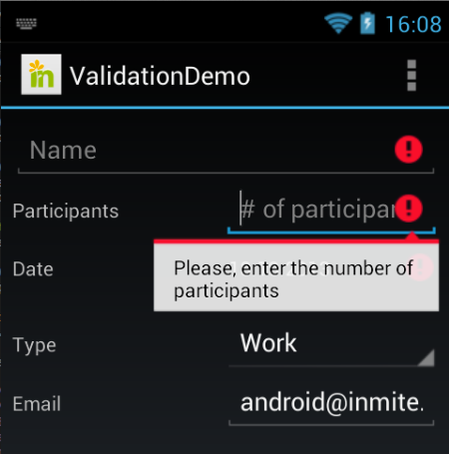
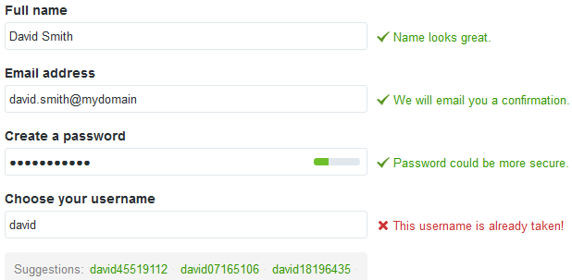
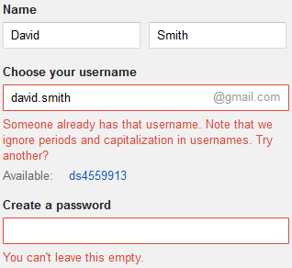
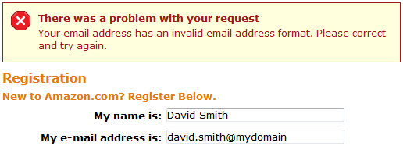
Motivation
Notes:
Most information systems do not allow specific measurements for DQ requirements to be defined, but rather rely only on a set of constraints which validate to either true or false. Therefore, either a user enters valid data and is able to store it in the database or the data is rejected.
As you can see in the examples above the feedback on most of the fields is either valid or invalid. Usually, there is additional information provided which gives hints for a proper correction of the data. Few validations give a non binary feedback such as the password validation in the upper right case. But the validation is only based on very simple rules.

Slide 5
Motivation cont.
Valid / invalid not sufficient
Distinguish several levels of DQ
Requires another concept for validation and
metrics for DQ
How and when to give feedback
Notes:
In many cases, this is not sufficient, as it might be appropriate to distinguish several levels of DQ or even use a continuous range from very poor DQ to very good DQ. This requires another concept for validation as well as metrics for DQ. Further, one needs to examine how and when users should be given feedback about DQ based on such metrics.

Slide 6



How to ensure DQ in an information system?
Data input process
  User Interface
  Business logic
  Database
Data analysis
  Database
Input Validation
Feedback
Restriction:
Data of poor quality
cannot be entered
Analysis Validation
Feedback
→ Data cleaning
Notes:
How can good quality of data in an information system be ensured?
Most obviously, we think first of restricting the input process so that data of poor quality cannot be entered into the system. This can be done at the UI level, within application programs or at the database level using constraints.
Alongside data input validation, there exists the possibility of analysing the quality of the data already stored in the database. Users (or power users) can then be informed about any problems and take actions to deal with them. Such an analysis is related to DQ assurance or data cleaning which is concerned with the correction and improvement of data in databases.

Slide 7

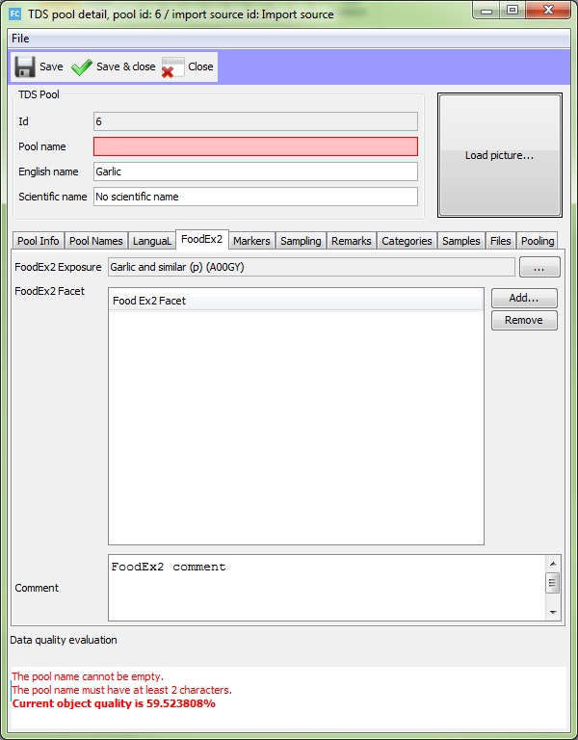
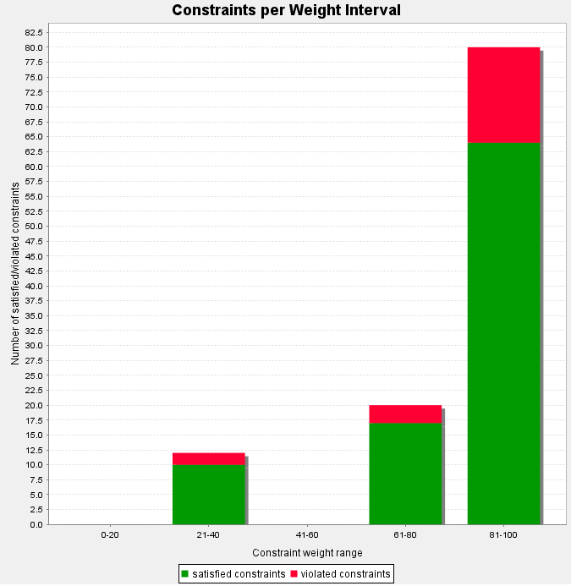

Data Quality Input & Analysis Feedback (DQIF / DQAF)
DQIF
DQAF
Prevention of
low Data Quality
Data Quality Analysis
Data quality input validation
& direct feedback on individual entities
Data quality analysis
& feedback on multiple entities
Notes:
For both types of validation it is necessary to give feedback to the user to enable the user to correct the data. We introduce two types of feedback to distinguish between direct feedback on individual entities given during data input and feedback resulting from an analysis of the database. We refer to the former as Data Quality Input Feedback (DQIF) and the latter as Data Quality Analysis Feedback (DQAF).

Slide 8
General DQ Framework
Concept
Enhanced functionality for defining, validating, measuring and visualising DQ
Helps users monitor constraints and DQ
Includes the validation and feedback for both DQIF and DQAF
DQ Requirements
156 identified specific to the food science domain
Definition of own DQ measurements
Configuration of customised DQ feedback
Notes:
Based on the results of the analysis in the previous work, we integrated enhanced functionality for defining, validating, measuring and visualising DQ into the application FoodCASE which is a system that is used for instance for managing the Swiss Food Composition Database (SFCD).
Based on constraint definitions, FoodCASE provides the measurements, calculations and visualisation components for visualising DQ and helps users monitor constraints and DQ. The concept and implementation includes the validation and feedback for both DQIF and DQAF.
Our DQ framework is general and application developers can define their own DQ measurements and configure customised DQ feedback. We identified 156 DQ requirements specific to the food science domain which are validated in FoodCASE and to which the end user gets DQ feedback.
In the following slides, we provided details of the DQ analysis toolkit and report on an evaluation of what and how DQ feedback is given to users.

Slide 9
Approach
Central element: DQ Requirements (DQRs)
Hard constraint
  Necessary condition
  Data quality is deficient
  Errors
Soft constraints & indicators
  Validated in a more relaxed way
  Recommendation
  Increase or decrease data quality
  Warnings
Notes:
Based on Requirement-Oriented Data Quality Model (RODQ).
Our DQ analysis toolkit is based on the concept of a Requirement-Oriented Data Quality Model (RODQ).
The central element of an RODQ model is the DQ Requirements (DQRs) where we distinguish three types of DQRs:
A hard constraint (HC) is a DQR which absolutely must be fulfilled. If a HC is violated, the data is invalid and cannot be used. Therefore, the system should enforce HCs and not allow input data to be stored unless all HCs are satisfied.
A soft constraint (SC) is a DQR which is highly recommended to be fulfilled. If a SC is not satisfied, DQ decreases. However, it might not always be possible to adhere to all SCs. Hence, they cannot be enforced by the system.
An indicator is a property that can be used to estimate DQ, rather than a constraint that can be clearly satisfied or not. A typical example is the age of the data. If the data is old, it is likely to be outdated, but it is still possible that it is correct.
Alternative:
Our approach distinguishes two types of constraints: hard constraints and soft constraints. Hard constraints such as integrity constraints are necessary conditions that data has to fulfil to be valid. If a hard constraint is violated, data quality is deficient. For example, a hard constraint could specify that an attribute value for email address has to contain an @ in order to be valid. To offer more flexibility, soft constraints are constraints that are validated in a more relaxed way compared to hard constraints. They could also be seen as recommendations since they are not just valid or invalid, but rather increase or decrease data quality. For example, an attribute description could be recommended to be longer than 30 characters to increase data quality. Another example is the age of data, which could indicate that data is outdated. Violations of soft constraints do not lead to errors, but the user is instead informed of possible data quality deficiencies.

Slide 10
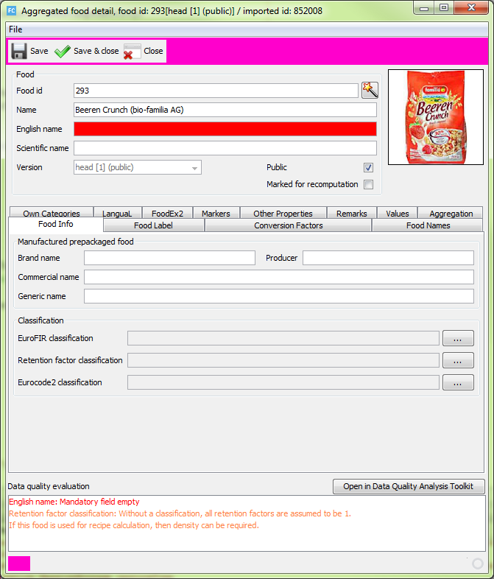
DQIF Example
Notes:
As already introduced, we distinguish between DQIF and DQAF. Both make use of the DQRs defined in the information system. DQIF is only concerned with the DQRs of the input data entity which can include relations to other entities whereas DQAF analyses all DQRs in the information system.
For each type, we will present an example from the FoodCASE system and describe briefly how feedback is given to the user.
We start here with the DQIF, where this figure shows an example of the DQIF for a food entity.
On every screen where data can be edited, there exists a DQ evaluation panel at the bottom. This panel lists all problems of the current data record.
Problems are divided into two categories: errors and warnings. Errors correspond to the violation of HCs and are displayed on the panel in red: If any are present, the data cannot be saved. Warnings corresponding to the violation of SCs or indicators are displayed on the panel in orange. No additional background colour change is triggered for warnings.
Concerning the where, how and when of giving feedback, we decided to give all textual feedback in a single location below the input area with the colouring indicating the severity of the problems. We only use the evaluation panel for textual feedback since the error and warning messages are often rather long and it would be difficult to show an abbreviation close to the appropriate field with such a high density of information and UI components as in FoodCASE. We also indicate where HCs have been violated by changing the background colour of appropriate fields. This is only done for HCs to keep the colouring within the input area to a minimum. The validation is triggered when the focus is moved from a field and consequently feedback is given immediately on data input for single components in the input area. We do not check the input as the user is entering data since we wanted to reduce the client server communication for performance reasons. The DQ evaluation panel also shows hints for how problems can be repaired if this information has been provided with the appropriate DQR.

Slide 11
DQAF Run
Run a DQ assessment
  All relevant data is fetched from the database
  All DQRs are checked
  Presentation of the DQ is prepared
  The results are stored in the database for later analysis
Triggered manually or by a timer
Variety of different charts and tables support the user in judging where action is needed
Notes:
For the DQAF, our DQ analysis toolkit first runs a DQ assessment where all relevant data is fetched from the database, all DQRs checked, the presentation of the DQ prepared and the results stored in the database for later analysis. Thus, it can be considered as a snapshot of the current DQ in the system. A DQ assessment can be triggered manually by the system administrator or automatically by a timer. Upon completion, a variety of different charts and tables support the user in judging where action is needed.

Slide 12
DQAF DQ Measurement - Example
Example DQR for customers:
‘For every person, last name and first name must be provided’
Last name but not the first name is known
DQR is only partially fulfilled
DQ could be defined to be 0.7 (70%)
Notes:
In our toolkit, every DQR is assigned a type (HC / SC / indicator) which determines how the associated DQ measures will be rendered.
Each DQR has to map every data record in the DQ entity to a DQ value between 0.0 (worst) and 1.0 (best). If a DQR is not applicable to a certain data record, NULL may be returned.
For example, if a database table contains data about customers, a DQR could be defined as ‘For every person, last name and first name must be provided’. Now if there is a customer for whom only the last name but not the first name is known, the DQR is only partially fulfilled. So the DQ could be defined to be 0.7 (70%) because usually the last name is more important than the first name. If a customer is not a person but a company, the DQR is not applicable, so NULL should be returned.
Once all DQRs are gathered, similar DQRs can be grouped together. This process can be repeated recursively ending up with a DQ tree. The root node will then be a single number representing the overall DQ. Since the grouping of the DQRs may be a matter of individual taste, it is possible to define different DQ analysis trees using the same DQRs. Similarly, the importance of the DQR may be controversial. Because of this, the weight of each DQR can be specified in each tree definition independently.

Slide 13
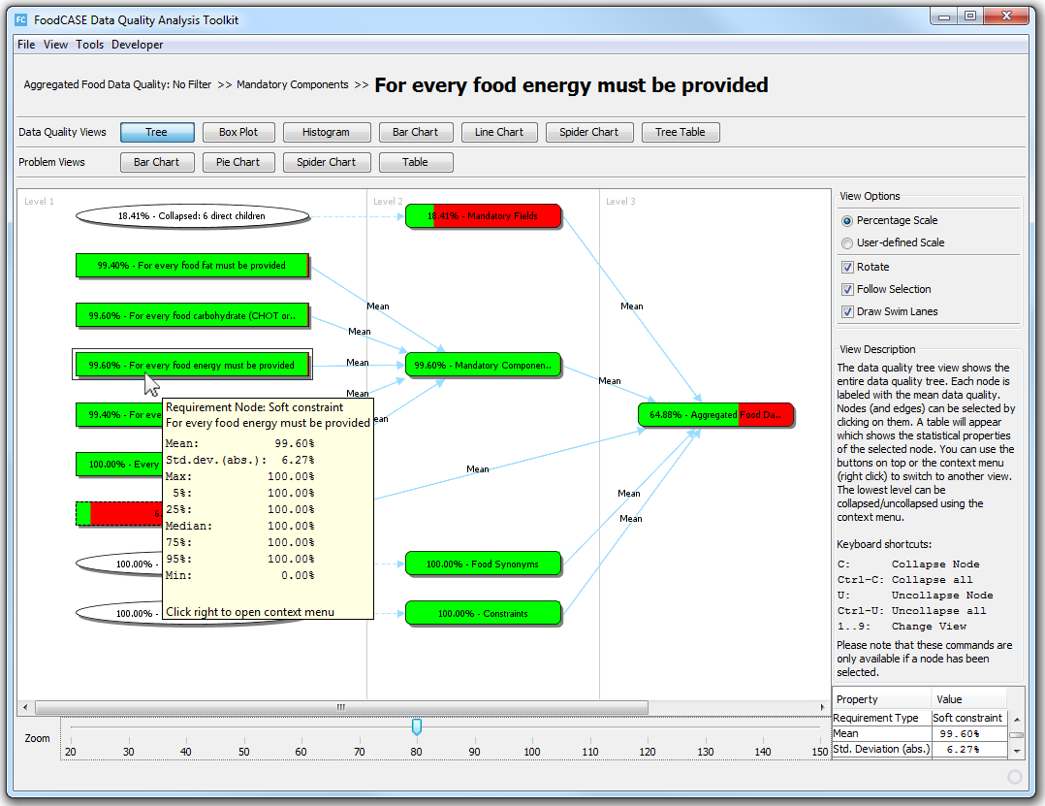
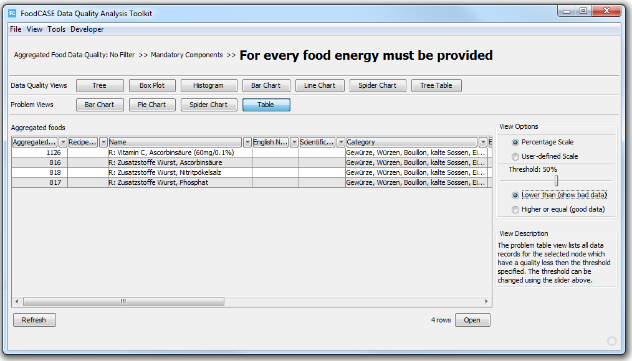
DQAF: DQ Views & Problem Views
Notes:
The DQ analysis toolkit provides a total of eleven different views which can be divided into two categories:
DQ views provide an overview of the DQ by visualizing the DQ of either a selected tree node and its direct children or the entire DQ tree.
Problem views on the other hand provide the possibility to drill down on the DQ issues and identify individual problems.
The toolkit provides flexible means of allowing users to configure their own analysis tree definitions and analysis runs. We will only show here an example of one of the many possible visualisations where the feedback is shown as a tree.

Slide 14
DQAF: Tree Views
Notes:
The DQ tree view shows the entire DQ tree with each node labelled with the mean DQ. Nodes (and edges) can be selected by clicking on them. A table will appear which shows the statistical properties of the selected node. All nodes are rendered as progress bars indicating the DQ of the criteria they represent. By default, all the DQ values in the DQ analysis toolkit are displayed as percentages.
The Tree serves as our main DQ view since it gives the best overview and navigation options.
As an indication of the performance of the DQAF integrated in FoodCASE, the calculation of all DQ requirements represented in a complex DQ tree for the Swiss Food Composition Database, including the subsequent rendering, takes several minutes, for example a quarter hour.

Slide 15
DQAF: DQ Views & Problem Views
Notes:
From this overview, it is possible to drill down on the DQ issues and identify individual problems in the data. The user can switch to the problem table view which you can see in this figure.
By double-clicking on a row, the data record is opened in the appropriate FoodCASE entity editor screen and the problem can be fixed.

Slide 16
Evaluation
Presentation of our information system with the integrated DQ analysis toolkit to food science experts
Subsequently conducted a survey
Participants had a variety of roles
16 participants completed the questionnaire
Notes:
To evaluate how the data quality (DQ) feedback of our information system is perceived by users and how it can be improved, we presented our information system FoodCASE with the integrated DQ analysis toolkit to food science experts and subsequently conducted a survey.
After the presentation of the information system and a subsequent extensive discussion in the plenum, we provided a questionnaire which the participants had to fill out. A total of 16 participants completed the questionnaire, which, although a relatively small number, included food science experts from most of the partners involved in the TDS-Exposure project.

Slide 17
Evaluation cont.
49 questions on various topics:
DQ in general
Who should be able to define DQ requirements
How should DQ requirements be defined
How should DQ feedback be given to users
Distinction between hard constraints (HC) and soft constraints (SC)
Personal information and user skills
Notes:
The questionnaire included 49 questions on various topics such as ‘DQ in general’, ‘Who should be able to define DQ requirements’, ‘How should DQ requirements be defined’, ‘How should DQ feedback be given to users’, ‘Distinction between hard constraints (HC) and soft constraints (SC)’ and ‘Personal information and user skills’. For the sake of simplicity, we only distinguished between HCs and SCs in the questionnaire by including the indicators in the category of SCs. For each question, the participants could choose from a five-level Likert-type scale if they ‘Strongly agree’ (SA), ‘Agree’ (A), are ‘Neutral’ (N), ‘Disagree’ (D) or ‘Strongly disagree’ (SD).

Slide 18
Results and Findings
An information system should clearly offer the functionality to analyse and improve DQ.
Access to data should be controlled and restricted. At the same time, providing users with the possibility to recall the change history of data is clearly important where changes should be traceable to users.
It should be possible for the institution using the software to define DQ requirements, but this should be done by a non-IT person and limited to ‘power users’.
DQ requirements should be managed in one place and in a unified way.
Notes:
We present here the most interesting findings from the survey by summarising the results and providing a short list of the most important key findings for DQ feedback.

Slide 19
Results and Findings cont.
It should be possible to rate the relevancy of each DQ requirement because not all requirements have the same importance.
It is clearly not preferable to provide the possibility to deactivate all DQ requirements.
A summary such as ’5 of 9 DQ requirements are satisfied‘ would motivate users to increase DQ.
A panel at the bottom of a GUI is a good solution for the DQ feedback but, for a lot of users, it would be preferable if DQ feedback was displayed close to the corresponding field(s).

Slide 20
Results and Findings cont.
An accentuation such as highlighting or colouring the corresponding field(s) and the usage of colours to indicate different types of DQ requirements is considered helpful.
The distinction between HCs and SCs is useful and both types should exist.
The number of HCs should be as small as possible with most users prefering to have more SCs than HCs.

Slide 21
Questions
?
Notes:
Thank you for your attention.
I am now open for your questions.

Slide 22
Conclusions
Our information system FoodCASE already provides the following
The functionality to analyse and improve DQ.
The access to data is controlled and restricted.
It is possible to recall the change history and each change of data is traceable to a given user.
DQRs can be defined by certain power users.
It is possible to rate the relevancy of each DQR by defining custom DQ feedback trees with custom weights of certain DQRs.
The definition of DQRs as hard constraints, soft constraints or indicators is possible and the user is free to decide how to categorise individual DQRs.
Feedback distinction between different types of DQRs is visualised in the DQ evaluation panel at the bottom of each screen.
Notes:
Our information system FoodCASE already provides the following: (1) The functionality to analyse and improve DQ. (2) The access to data is controlled and restricted. (3) It is possible to recall the change history and each change of data is traceable to a given user. (4) DQRs can be defined by certain power users. (5) It is possible to rate the relevancy of each DQR by defining custom DQ feedback trees with custom weights of certain DQRs. (6) The definition of DQRs as hard constraints, soft constraints or indicators is possible and the user is free to decide how to categorise individual DQRs. (7) Feedback distinction between different types of DQRs is visualised in the DQ evaluation panel at the bottom of each screen.

Slide 23
DQIF Aspects
Where
  Close to the input data
  Outside of the input area (above or below)
How
  Textual
  Symbols
  Colouring (messages, field labels or field itself)
When
  single data item is entered
  all data in an input area has been entered
Notes:
There exist many possibilities for UI data input validation feedback. In the paper we give an overview of the most common techniques and distinguish three aspects of the feedback: (1) where, (2) how and (3) when.
1. In a UI, usually there exists an input area and many input components such as form fields. Feedback can be given close to the input data (for example above or to the right of a field or as a tool tip) or outside of the input area (above or below).
2. How to give feedback also depends on where the feedback is given. Textual feedback or feedback with symbols (for example a stop sign) can be given anywhere. The feedback can be supported by colouring the various components such as messages, field labels or the field itself. Usually green, yellow and red are used to show the different states from valid to invalid data. When colouring a field, there exists variations such as a glow effect or change to the line or background colour.
3. Validation and feedback can take place either when a single data item is entered or after all data in an input area has been entered. A validation time could, for example, be defined as when the focus changes from one field to another or when pressing a specific button. It is also possible to check the input as the user is entering it in the case of an input text field.

Slide 24
DQIF Relevant Information
Usually feedback about one data entity
An error has occurred
Where the error occurred
How the error can be repaired
(includes type of error)
Notes:
If the data submitted by the user is valid, it is good practice to let the user know that everything went as planned.
If it is invalid, the user should be informed (1) that an error has occurred, (2) where the error occurred and (3) how the error can be repaired. Thus, feedback not only involves highlighting where an error occurred but also providing information about what is missing or needs to be changed in order for the data to be valid or of higher quality.

Slide 25
DQAF Aspects
Usually feedback about multiple or all entities in a database at the same time
Where are corrections required
→ Visualisations
Navigation: Overview → Individual data entities
Notes:
In contrast to DQIF, the user gets feedback about multiple or all entities in a database at the same time in DQAF.
Therefore, the feedback should include ways of identifying areas where a correction might be required. Many different visualisations based for example on charts and tables can be used to give the appropriate feedback. It is also important to provide a means of navigating from overviews to individual data entities and their associated violations in order to identify problems.

Slide 26
DQAF DQ Measurement
DQ measures rendering dependent on DQR type (HC / SC & Ind.)
DQR has to map every data record in the DQ entity to a DQ value
DQ value between 0.0 (worst) and 1.0 (best)
Once all DQRs are gathered, similar DQRs can be grouped together. This process can be repeated recursively ending up with a DQ tree
Example DQR for customers:
‘For every person, last name and first name must be provided’
Last name but not the first name is known
DQR is only partially fulfilled
DQ could be defined to be 0.7 (70%)
Notes:
In our toolkit, every DQR is assigned a type (HC / SC / indicator) which determines how the associated DQ measures will be rendered.
Each DQR has to map every data record in the DQ entity to a DQ value between 0.0 (worst) and 1.0 (best). If a DQR is not applicable to a certain data record, NULL may be returned.
For example, if a database table contains data about customers, a DQR could be defined as ‘For every person, last name and first name must be provided’. Now if there is a customer for whom only the last name but not the first name is known, the DQR is only partially fulfilled. So the DQ could be defined to be 0.7 (70%) because usually the last name is more important than the first name. If a customer is not a person but a company, the DQR is not applicable, so NULL should be returned.
Once all DQRs are gathered, similar DQRs can be grouped together. This process can be repeated recursively ending up with a DQ tree. The root node will then be a single number representing the overall DQ. Since the grouping of the DQRs may be a matter of individual taste, it is possible to define different DQ analysis trees using the same DQRs. Similarly, the importance of the DQR may be controversial. Because of this, the weight of each DQR can be specified in each tree definition independently.

Slide 27
Future Work
Based on the evaluation outcome, we plan to
Define and manage the DQRs in one place in a unified way, probably by changing the DQR definitions to annotations in the entities and performing the validation by the means of BeanValidation (Java Specification Request 349).
Provide a DQ summary in each screen such as ’5 of 9 DQRs are satisfied‘ in order to motivate users to increase DQ.
Keep our evaluation panel for detailed feedback but add short DQ feedback close to the appropriate fields, probably by an additional accompanied symbol such as a light bulb with attached tooltip.
Notes:
Based on the evaluation outcome, we plan to: (1) Define and manage the DQRs in one place in a unified way, probably by changing the DQR definitions to annotations in the entities and performing the validation by the means of BeanValidation (Java Specification Request 349). (2) Provide a DQ summary in each screen such as ’5 of 9 DQRs are satisfied‘ in order to motivate users to increase DQ. (3) Keep our evaluation panel for detailed feedback but add short DQ feedback close to the appropriate fields, probably by an additional accompanied symbol such as a light bulb with attached tooltip.

Slide 28
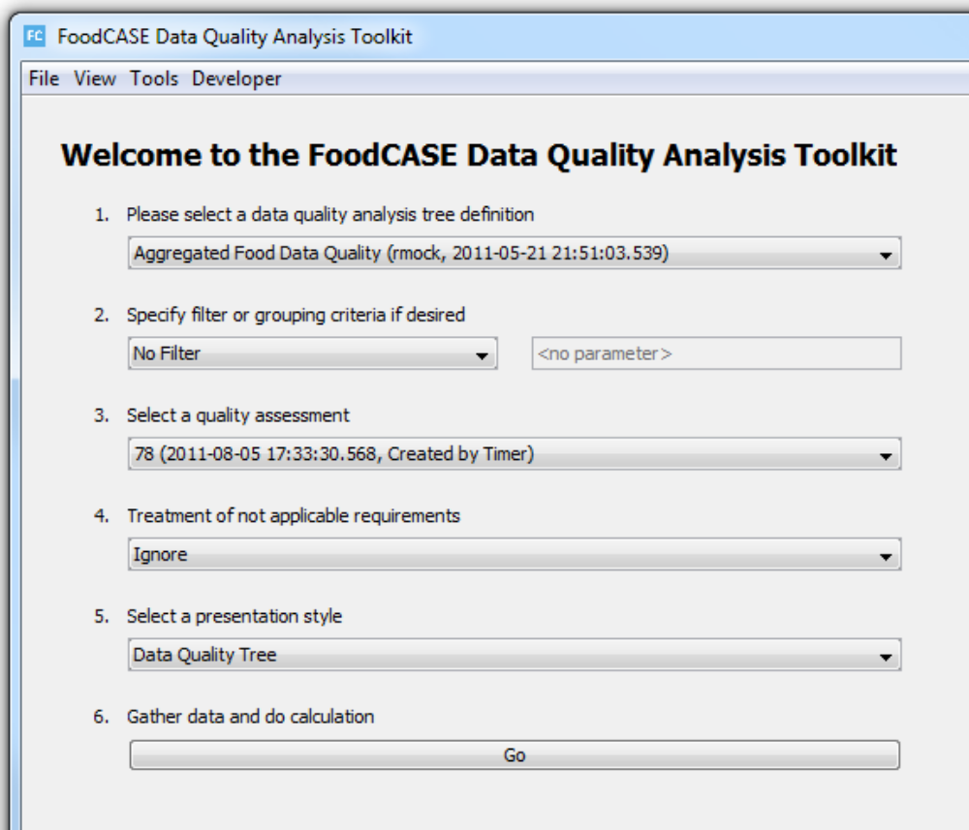
DQ Analysis Toolkit – Start Screen

Slide 29
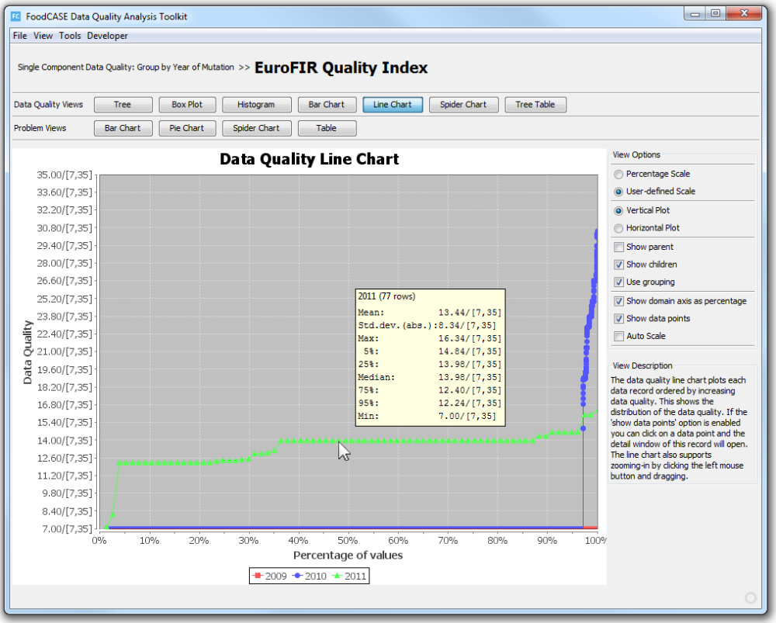
DQ Analysis Toolkit – Line Chart

Slide 30
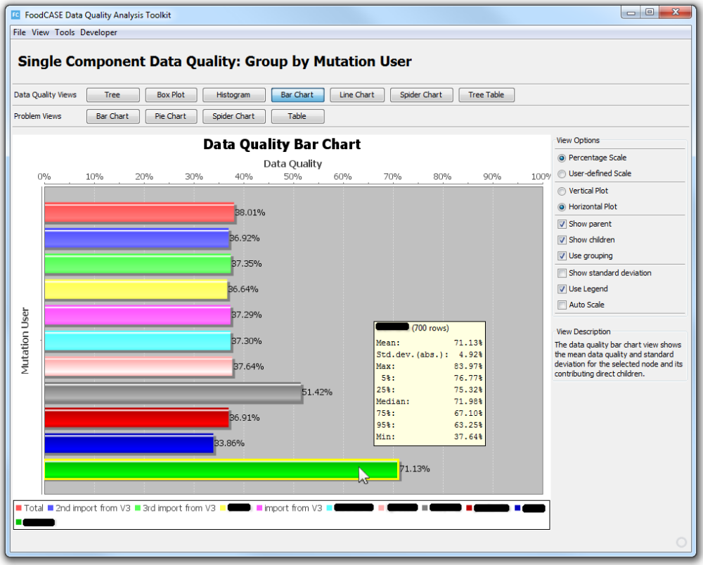
DQ Analysis Toolkit – Bar Chart

Slide 31
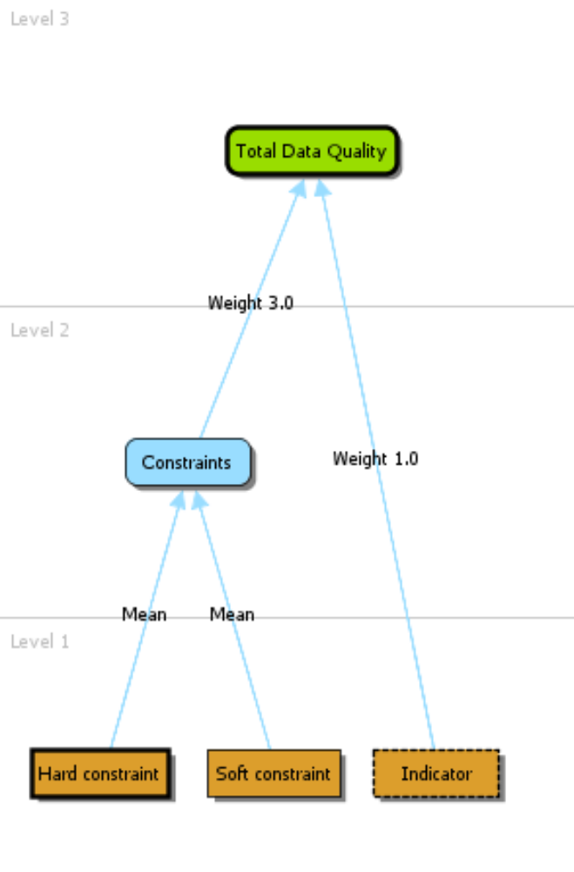
DQ Analysis Toolkit – Simple Tree Definition
Notes:
A very simple Tree Definition showing the different requirement types: hard
constraint, soft constraint and indicator. The aggregation node on level 2 uses aggregation
type mean. The root node uses weighted mean with the weights 3.0 and 1.0.

Slide 32
DQ Analysis Toolkit – Aggregation Types
Mean
Median
Minimum
Maximum
Geometric Mean
Weighted Mean
Notes:
The Aggregation Type of an aggregation node determines how the data quality value of the
aggregation node is computed from its direct children. The Data Quality Analysis Toolkit
provides six different aggregation types:
• Mean
• Median
• Minimum
• Maximum
• Geometric Mean
• Weighted Mean
The first five aggregation types need no further configuration. In case of Weighted Mean, a
weight has to be assigned to every in-edge. By default, every in-edge is given a weight of 1.0.

Slide 33
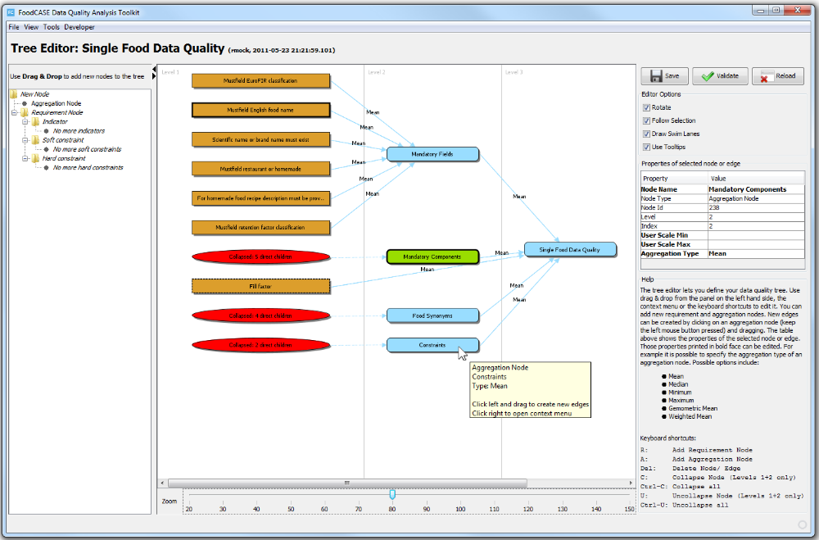
DQ Analysis Toolkit – Tree Editor
Notes:
The Tree Editor which allows to create own tree definitions. It provides three
ways to modify a tree definition: by using the context menu, the keyboard shortcuts or simply
by dragging a new node from the tree on the left-hand side into the graph area and dropping
it. If a tree node or edge is selected, a table will appear on the right-hand side showing the
properties of the selected object. Those properties printed in bold face can be modified by the
user. Instead of always starting from scratch, it is also possible to copy a tree definition from
someone else and modify it.

Slide 34
DQ Analysis Toolkit – Filtering and Grouping
Filter by Id (only consider a single data record)
Filter/group by creation user
Filter/group by year of creation
Filter/group by mutation user
Filter/group by year of mutation
Notes:
As already seen in the scenarios, it is possible to filter or group by a variety of properties. For
all six data quality entities, the following filters are provided:
• Filter by Id (only consider a single data record)
• Filter/group by creation user
• Filter/group by year of creation
• Filter/group by mutation user
• Filter/group by year of mutation
Additionally, every data quality entity has its specific filters. For example, the aggregated
foods can be filtered by the version of the database.

Slide 35
DQR definition
DQIF: Custom Java validation classes
DQAF: SQL statements
Notes:
The data quality (DQ) requirements are defined in custom Java validation classes for the DQIF whereas the DQAF makes use of SQL statements for the validation.

Slide 36
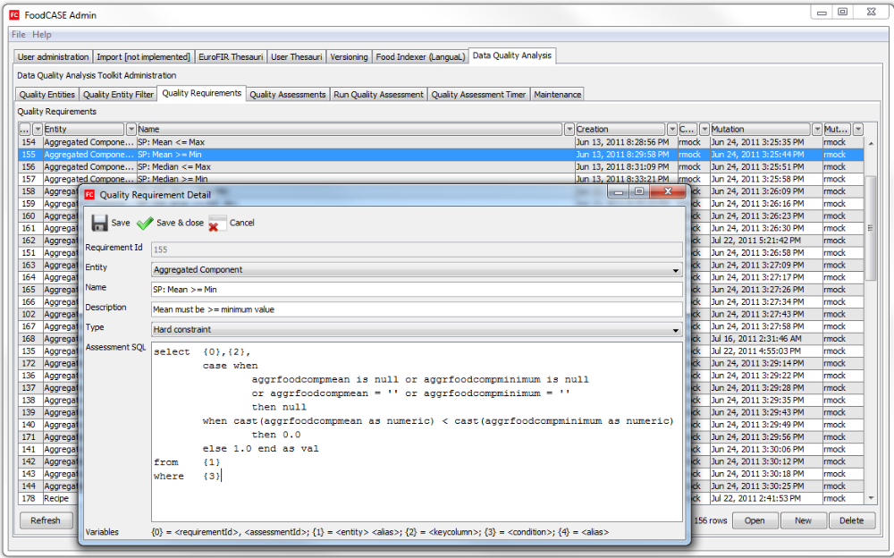
DQAF Data Quality Requirements (DQR) View
Notes:
The Quality Requirements view is probably the most interesting one. Here it is possible to
define the quality checks which have to be performed whenever a Quality Assessment is run.
As already mentioned in section 3.2.1, a quality requirement belongs to a quality entity and
has a type:
Entity Id: The Id of the entity on which the quality check has to be performed.
Example: 16
Name: The display name of the quality requirement.
Example: Mean >= Min
Description: An optional documentary description.
Type: Hard constraint, Soft constraint or Indicator
Assessment SQL: The SQL statement which is executed when a Quality Assessment is
performed. This SELECT statement must return one row for every
data record in the quality entity. Each row must have the format
frequirementId; assessmentId; refId; valueg. Value is the data
quality value of the data record identified by refId. It must be a number
between 0.0 (worst quality) and 1.0 (best quality). NULL may be
returned to express that the quality requirement is not applicable to a
certain data record.

Slide 37
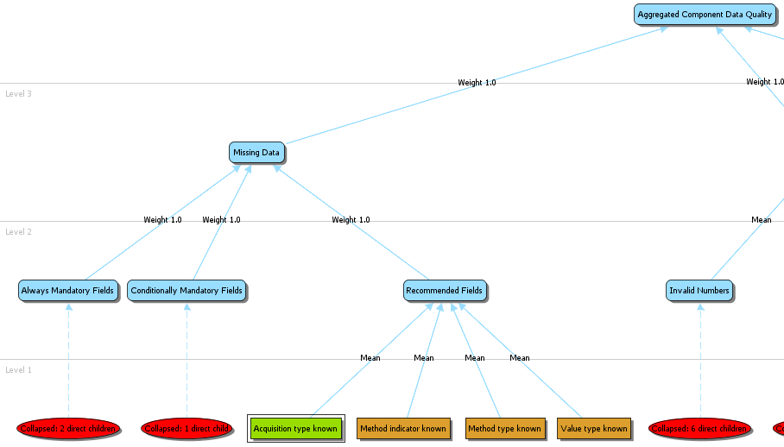
DQAF Data Quality Requirements (DQR) – Tree Editor Example

Slide 38
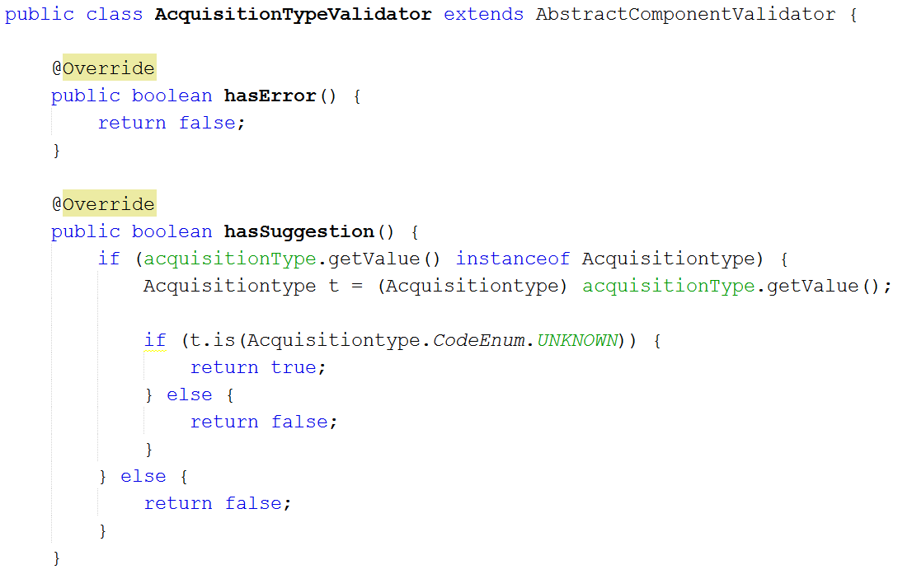
DQIF Data Quality Requirements (DQR)

Slide 39

Food Composition (FC) & Total Diet Study (TDS)
Food Composition data (FC data)
Nutritionally important components of foods
Values for energy and nutrients
Food composition databases (FCDBs)
Total Diet Study data (TDS data)
Similar to FC data but containing contaminant analysis values instead of nutrient values
TDS process is different to the FC process
Nutrient (beneficial): Vitamin C, protein
Contaminant (harmful): Mercury (heavy metal)
Notes:
We evaluated our approach in the field of food sciences where we are mainly concerned about Food Composition data and Total Diet Study data.
Food composition data (FC data) are detailed sets of information on the nutritionally important components of foods and provide values for energy and nutrients including protein, carbohydrates, fat, vitamins and minerals and for other important food components such as fibre. The data is presented in food composition databases (FCDBs) such as the Swiss Food Composition Database (SFCD).
Total Diet Study data is similar to FC data but containing contaminant analysis values instead of nutrient values. Allthough the data is similar the TDS process to getting the data is very different to the FC process.

Slide 40
Agenda
Motivation
How to ensure data quality in an information system?
Data quality input feedback (DQIF) &
Data quality analysis feedback (DQAF)
Our approach with Hard- & Soft-Constraints
  DQIF
  DQAF
Description of the evaluation
Results and findings
Notes:
After this introduction I will present you …

Slide 41
Main Contributions

